Slide 1
Employee Services Technical Support Frontline Tier 1 or Tier 2 Support for:
MAC OS X and Applications
Pritam Mukherjee
Technical Trainer
2nd January 2019

Slide 2
Training Agenda
Overview of Mac OS X and its Applications
Support Overview
Troubleshooting
Associated Links / Sites
Q&A
Notes:
Replace ‘Application Name’ in the Title with the actual Application or Service Name. The quotes can be removed also.

Slide 3
Overview of Mac OS X and its Applications
Notes:
Replace ‘Application Name’ in the Title with the actual Application or Service Name. The quotes can be removed also.

Slide 4
Overview
General Information of Apple Hardware & Mac OS X
Overview of MS Office 2016
Cisco AnyConnect
SofToken II and MobilePASS
Cisco WebEx, Jabber and Spark
VmWare Fusion
McAfee & FireAmp
Crashplan
OnRamp
Notes:
Provide a clear description of the application or service. i.e., what it is, what it does and how it is used.
Include a description of the features, functions and benefits for the targeted audience (Employee Services Technical Support teams).

Slide 5
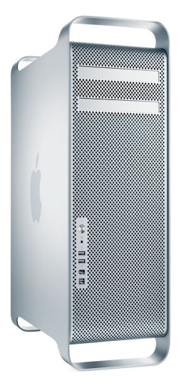




Different Apple Computers (Desktops & Portables):
Mac Mini
Mac Pro
iMac 21.5”/27”
MacBook Air
MacBook Pro

Slide 6
Generation of Mac OS X
Cheetah OS - 10.0 updated up to 10.0.4
Puma OS - 10.1 updated up to 10.1.5
Jaguar OS - 10.2 updated up to 10.2.8
Panther OS - 10.3 updated up to 10.3.9
Tiger OS - 10.4 updated up to 10.4.11
Leopard OS - 10.5 updated up to 10.5.8
Snow Leopard OS - 10.6 updated up to 10.6.8
Lion OS - 10.7 updated up to 10.7.5
Mountain Lion OS - 10.8 updated up to 10.8.5
Mavericks - 10.9 updated up to 10.9.5
Yosemite - 10.10 updated up to 10.10.5
El Capitan - 10.11 updated up to 10.11.6
Sierra- 10.12 updated up to 10.12.6
High Sierra - 10.13.6 (Latest Version as of July 2018)
NOTE: To install Mac OS, it requires an Apple Hardware (Apple Computer). Mac OS X was
available in 32 & 64 bit till Snow Leopard. From Lion OS X onwards, it’s available only in 64 bit.

Slide 7
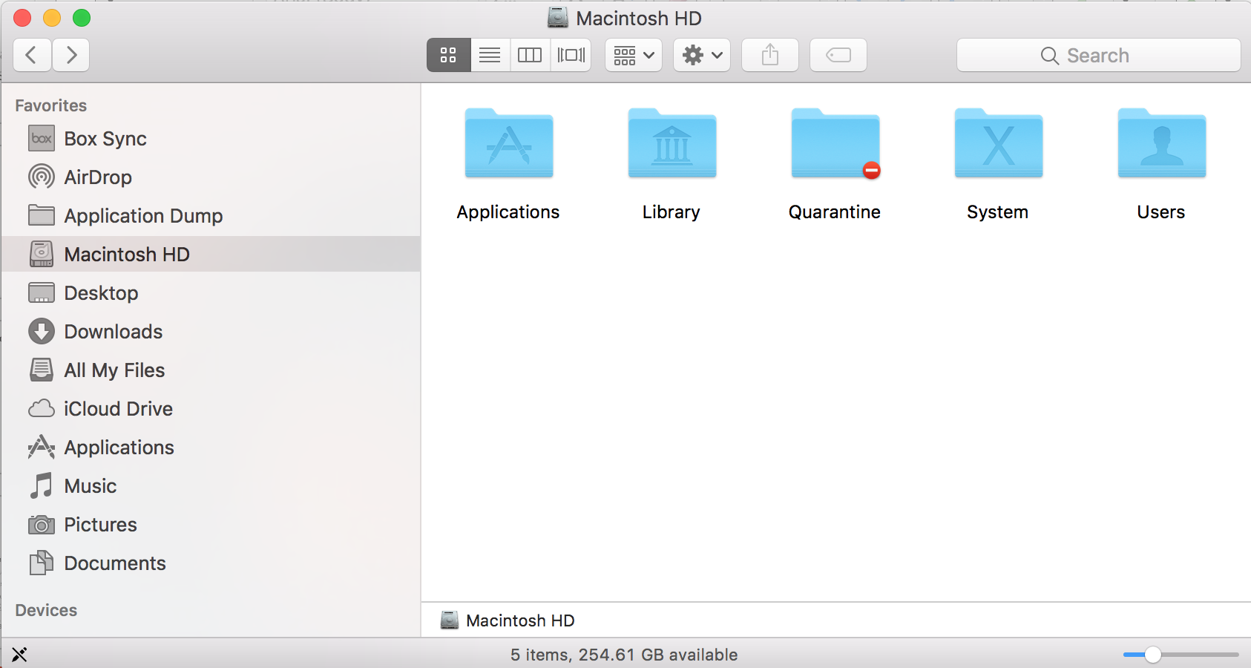
Understanding File System
Mac OS X has made up four
essential folders as Applications,
Library, System and Users
**** Each and every Library folder has a Preferences folder which contains the settings of individual applications in the form of .plist.
For example:
com.apple.addressbook.plist or com.microsoft.outlook.plist

Slide 8
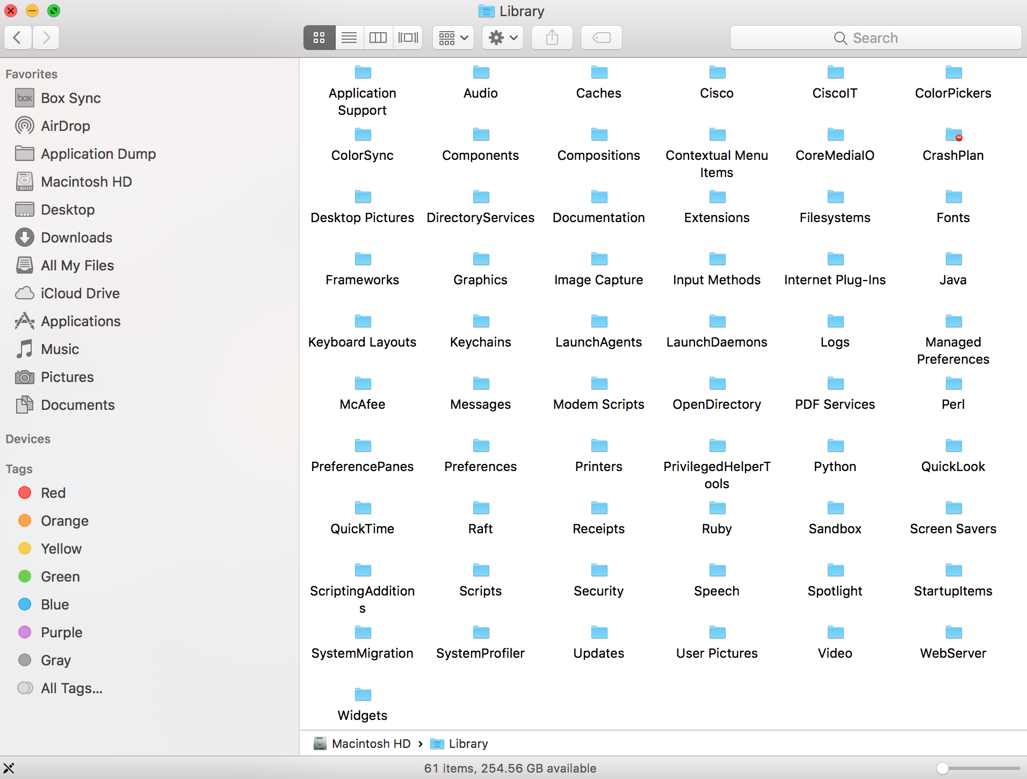
HDD Library
Library contains the files and
folders, which are required for the
Mac OS X, but it’s not essential to
run the basic operating System.
For example: Internet Plugins

Slide 9
Applications
Applications Folder contains all the default applications and other third
party applications in the format of .app. For example: Address book.app.
Installation of an application on Mac OS X is very easy. On Mac OS X, Installer helps to
install any applications on the Macintosh HD in ‘Applications’ Folder. By default the
entire applications install on the ‘Applications’ folder, but the applications can be installed on
other locations also, if required.
On Mac OS X, all the application comes up in .pkg or .mkpg or .dmg or .app format.
NOTE: Any application which comes in .app format is an executable file, which can be run
directly without extracting any packages.

Slide 10
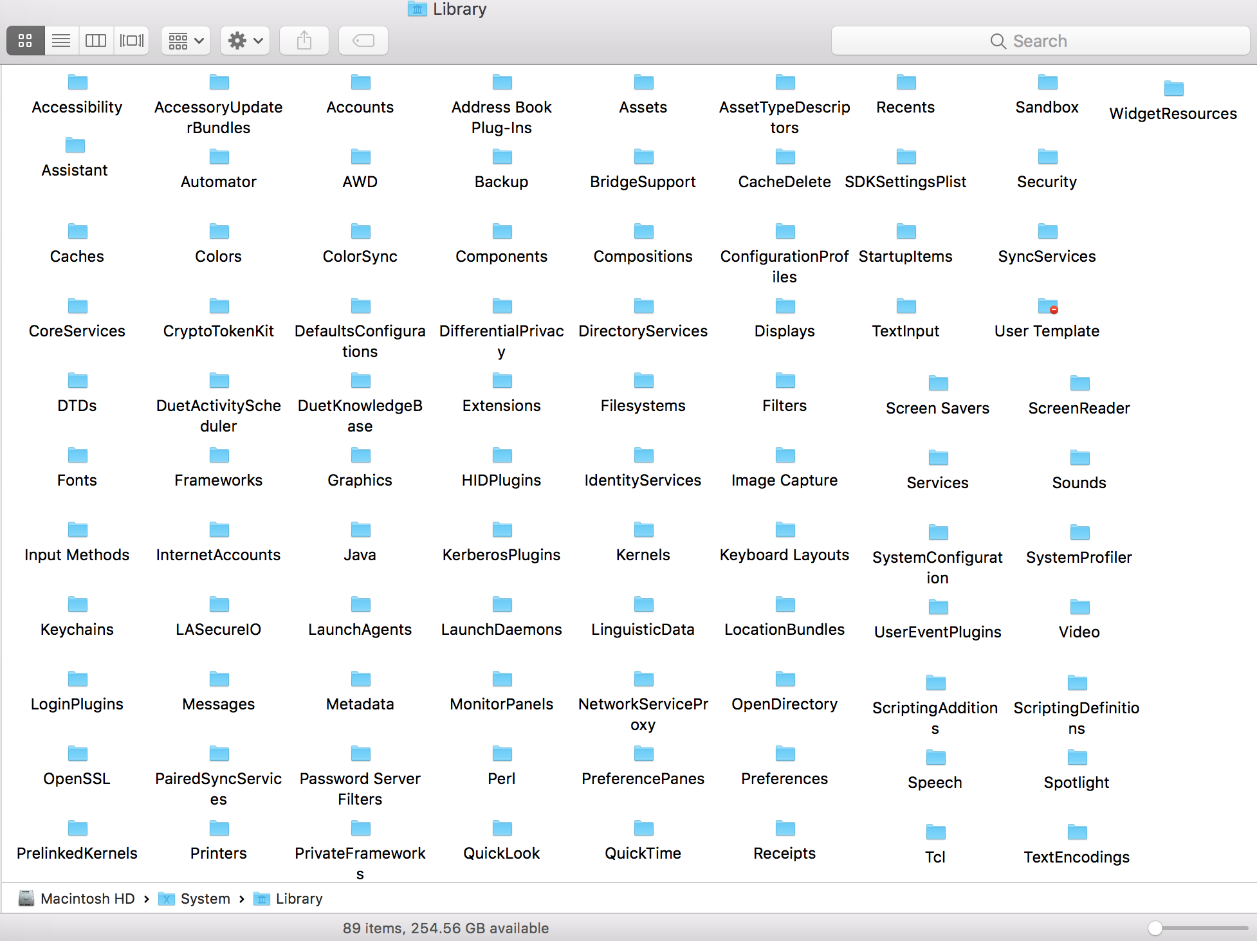
System
System contains a
Library Folder, which has
all the essential files to run the
operating System.
For Example: Core Services

Slide 11
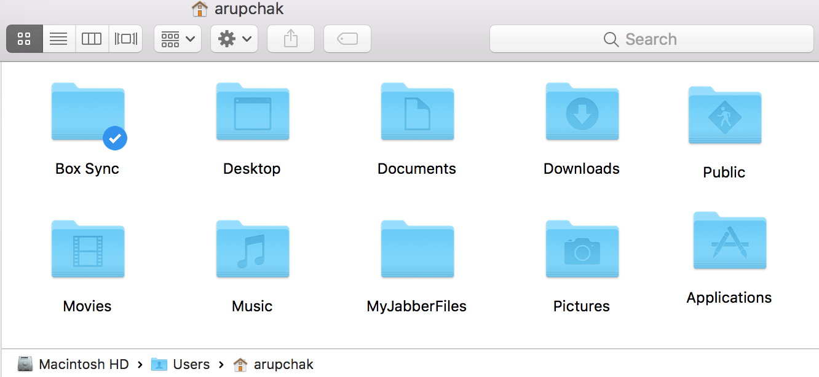
Users
Users folder contains of the
data of all the user accounts
along with a Shared folder.
Each and every user account folder made up of mainly 9 folders; Desktop,
Documents, Downloads, Library(hidden), Movies, Music, Pictures, Public

Slide 12
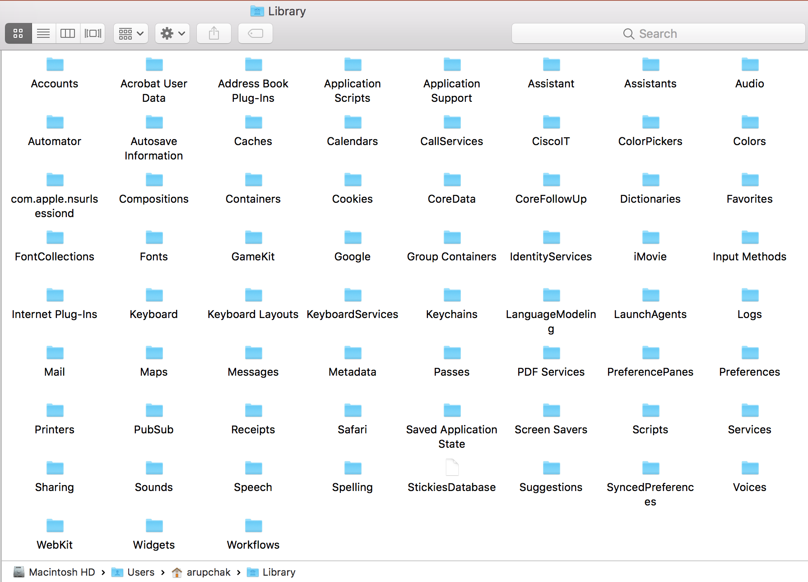
User Library
Library folder contains all the settings of the user account including the data of all user based applications.
NOTE: To access it, click on the Go option from the top menu bar after launching Finder window and then hold down the OPTION key on the keyboard.

Slide 13
Essential Applications and Utilities
System Preferences
System Preferences controls system-wide settings ("global" settings), and is available
from the Apple menu at the upper-left corner of the screen. System Preferences lets you
to adjust things like your screen resolution, keyboard control, mouse control, sound,
printer settings, sharing settings, accounts, and more. You can quickly locate the settings
you want to change by typing the desired subject in the search field. For example, to change
your login password, type "password." The preferences related to password appear below
the search field, and one or more preferences are spotlighted in the System Preferences
window. Click the item in the list that matches what you want to do, or click one of the
spotlighted preferences. The appropriate preference pane opens.

Slide 14
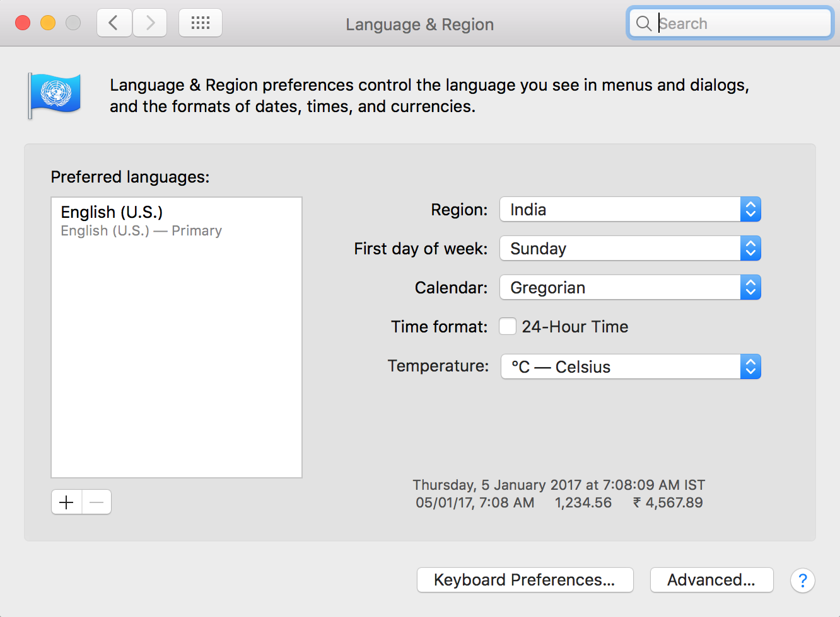
Essential Applications and Utilities
Language and Region
Language & Region option has created to set the Preferred and second Languages, Region and Calendar style.
If any user wants more than one language on Outlook, then set the Languages here accordingly. Make sure that English (US) should be selected as it has dictionary.

Slide 15
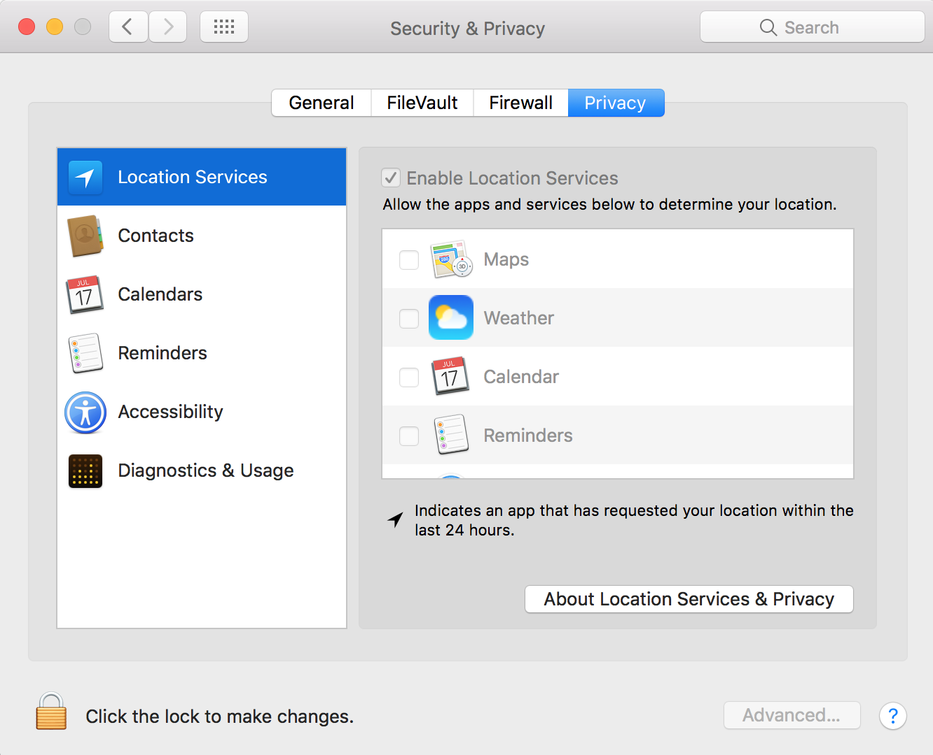
Essential Applications and Utilities
Security and Privacy
Security & Privacy has the setting of
Firewall(which allows you to accept or deny
incoming connections to your Mac by
application), FileVault (FileVault2 to
encrypt entire Macintosh HD) and Privacy
(offers a number of options that you can
set to keep your information secure.
In the sidebar, you'll see a list of items,
many of them simple: Contacts, Calendars,
Reminders all show which apps have
requested to access this information.
You'll see alerts when apps make such
requests.)

Slide 16
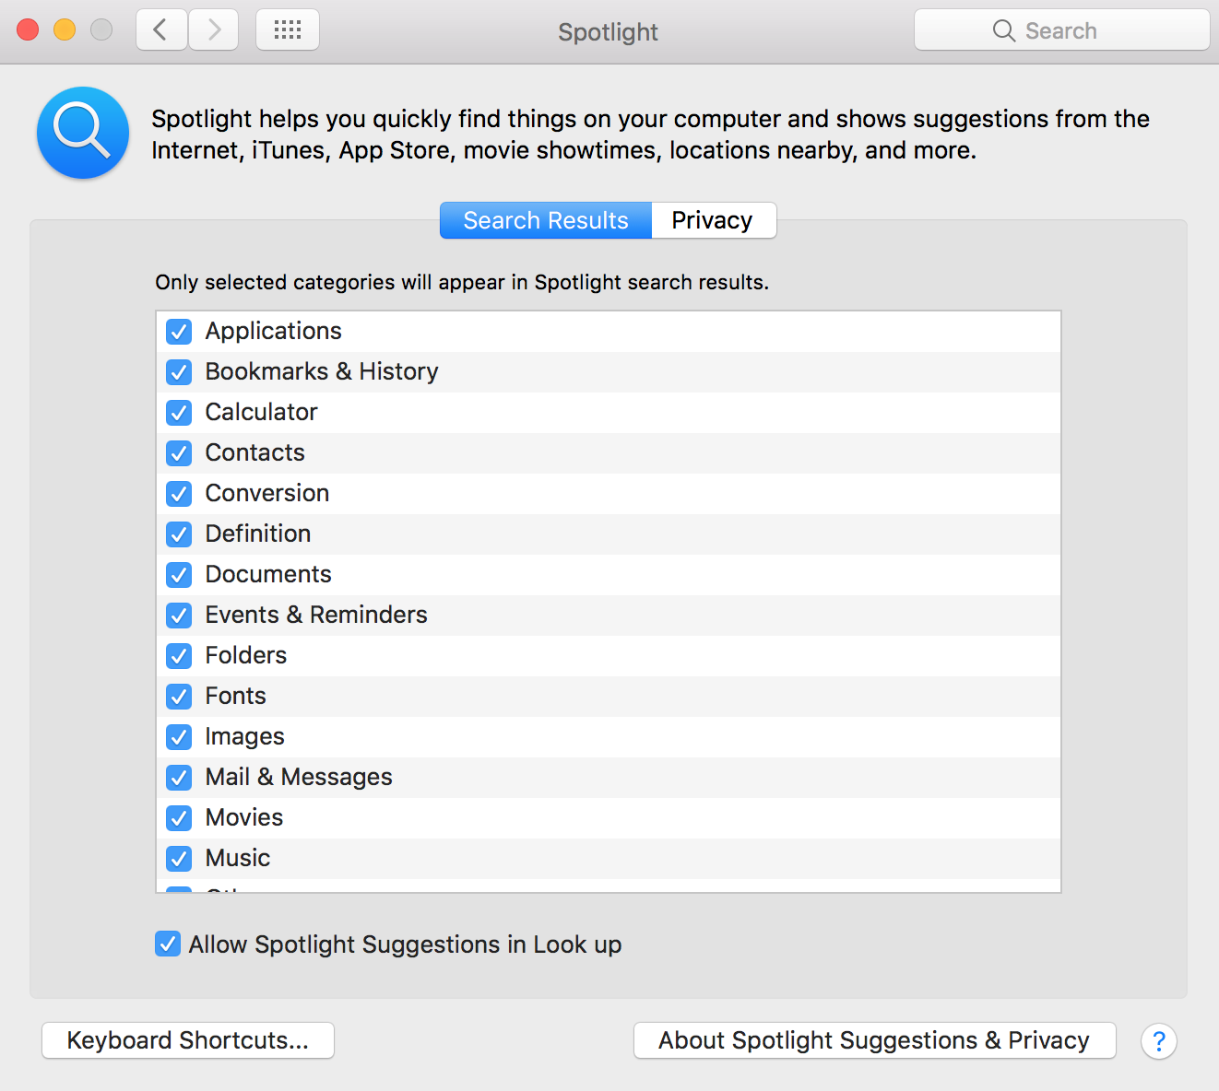
Essential Applications and Utilities
Spotlight
Spotlight manages the complete
indexing service of Mac OS X and all
installed applications Data. By default,
under Search Results all the categories are
checked to cover all kinds of data.
If any user wants to omit any particular
folder or file from search results, then we
need to add that folder under Privacy tab.
If any items are not appearing in search
results, then add and remove from Privacy
section.

Slide 17
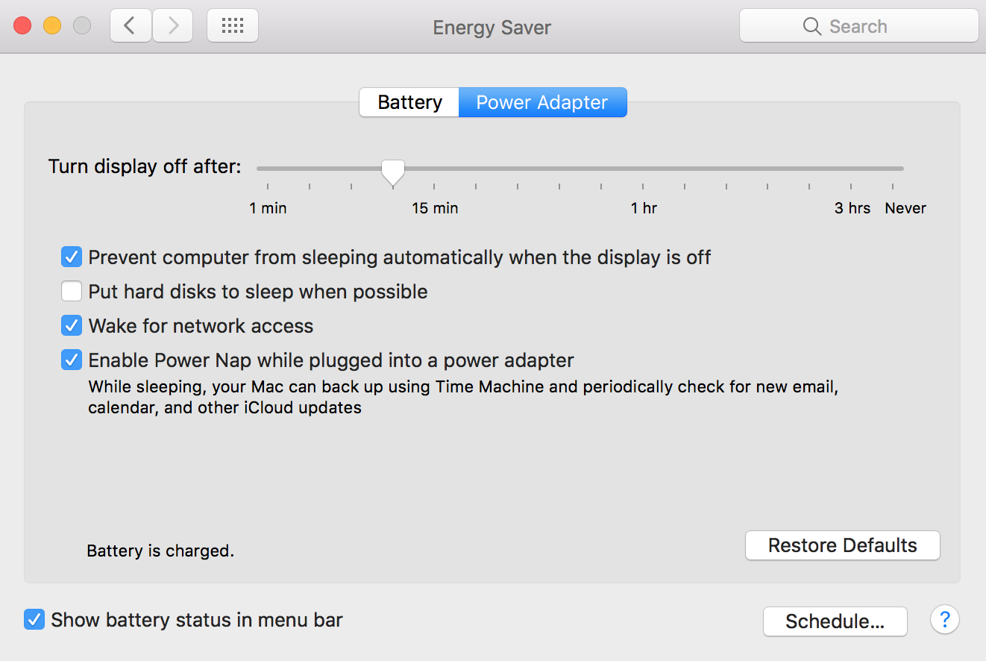
Essential Applications and Utilities
Energy Saver
The settings in Energy Saver affect
what happens when your Mac
is left unattended for a period of time
that you specify.
If the Mac is running out of Battery or
doesn’t go to sleep or wake up
properly, then click on Restore Defaults.

Slide 18
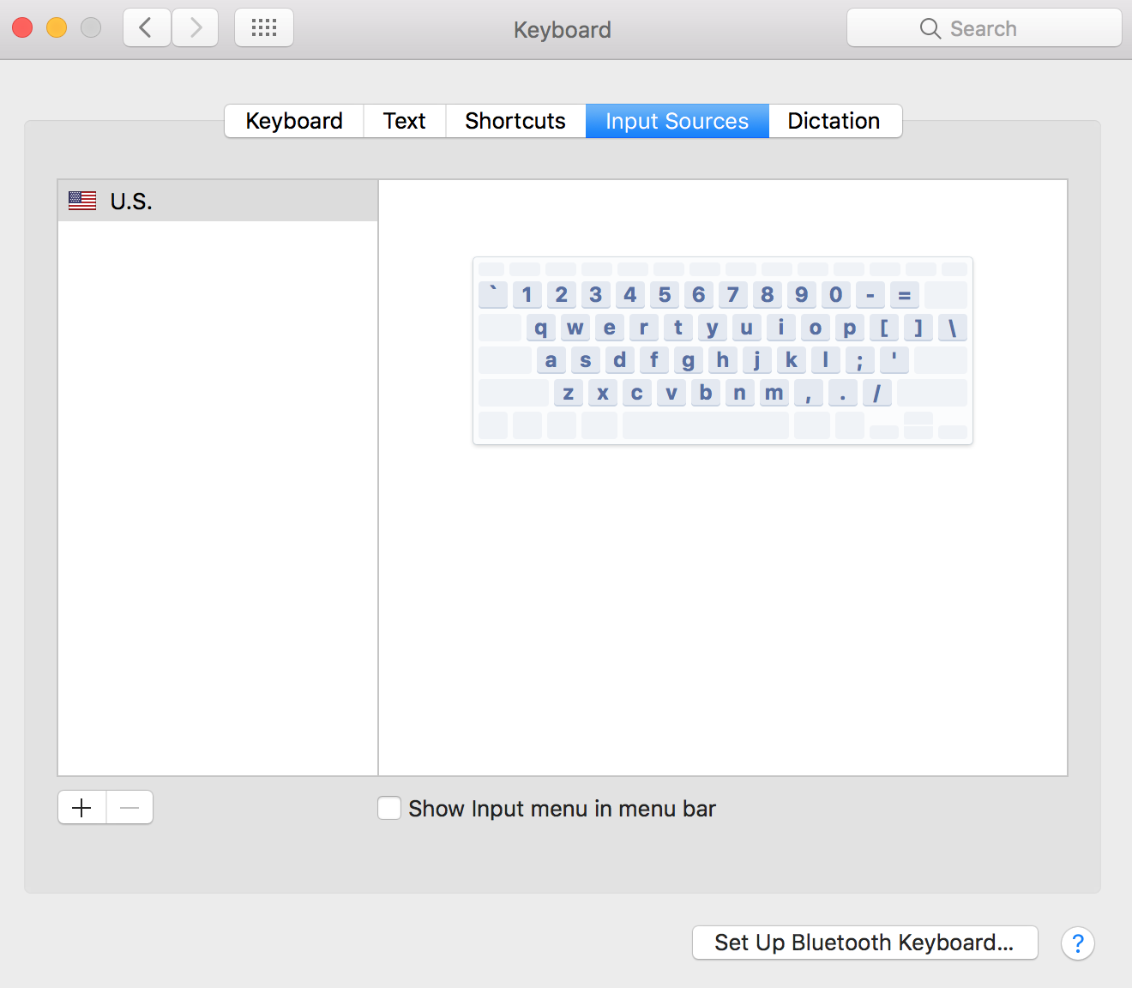
Essential Applications and Utilities
Keyboard
Keyboard option helps to change the
Keyboard Preferences, setup Bluetooth
Keyboard, assign keyboard shortcuts and to
setup the replacement words.
Whenever any user get a login issue,
where the password is correct, but still Mac
OS is not accepting the password; in that
case, make sure that the keyboard
Layout has selected as U.S. by default after
login to the Mac.

Slide 19
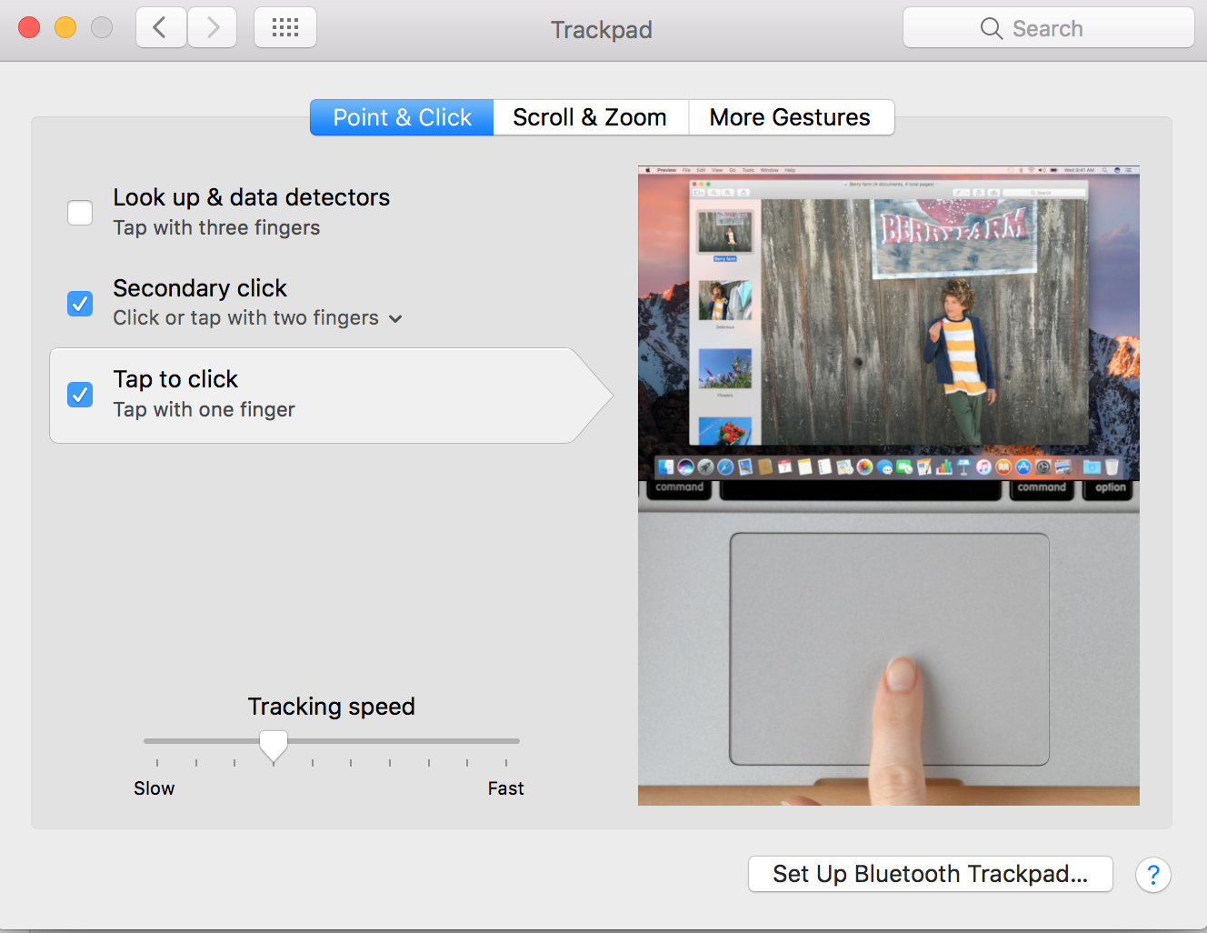
Essential Applications and Utilities
Trackpad
Trackpad option helps to change
the Trackpad settings of portables and
for external Trackpad. Use the
appropriate tabs to change the settings
of Trackpad preferences.
By default, Tap to Click option is
disabled and user has to use hard
click on the trackpad initially and then can
be enabled here.

Slide 20
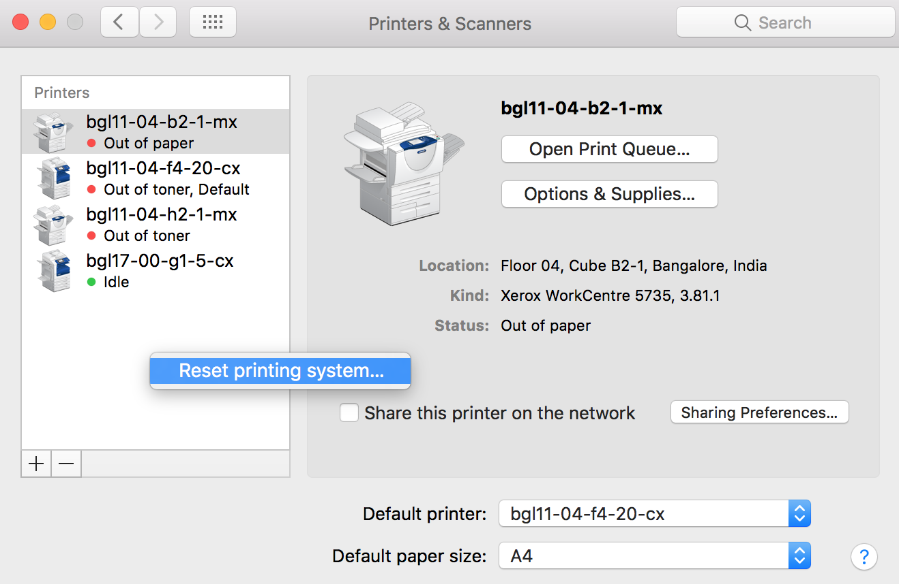
Essential Applications and Utilities
Printers & Scanners
Printing and Scanning plays a vast role on Mac OS X.
There are four different kinds of printers can be added on
Mac; Default (USB or Bonjour Shared Printer),
Windows Shared Printer, IP Printer.
USB Printer is the one which connects directly to the Mac
and then takes the printout.
IP Printer is the one which is connected to an Ethernet
port or connected through Wireless and collects the
printing packages through an IP address. IP Printer has to
be configured as the information provided by the printer
manufacturer.
Windows Shared Printer is the one which is connected to a windows Client or Server and both Mac &
Windows computers are joined to the same Local area network.
NOTE: Printers can be reset by Right clicking on the installed printers list pane.

Slide 21
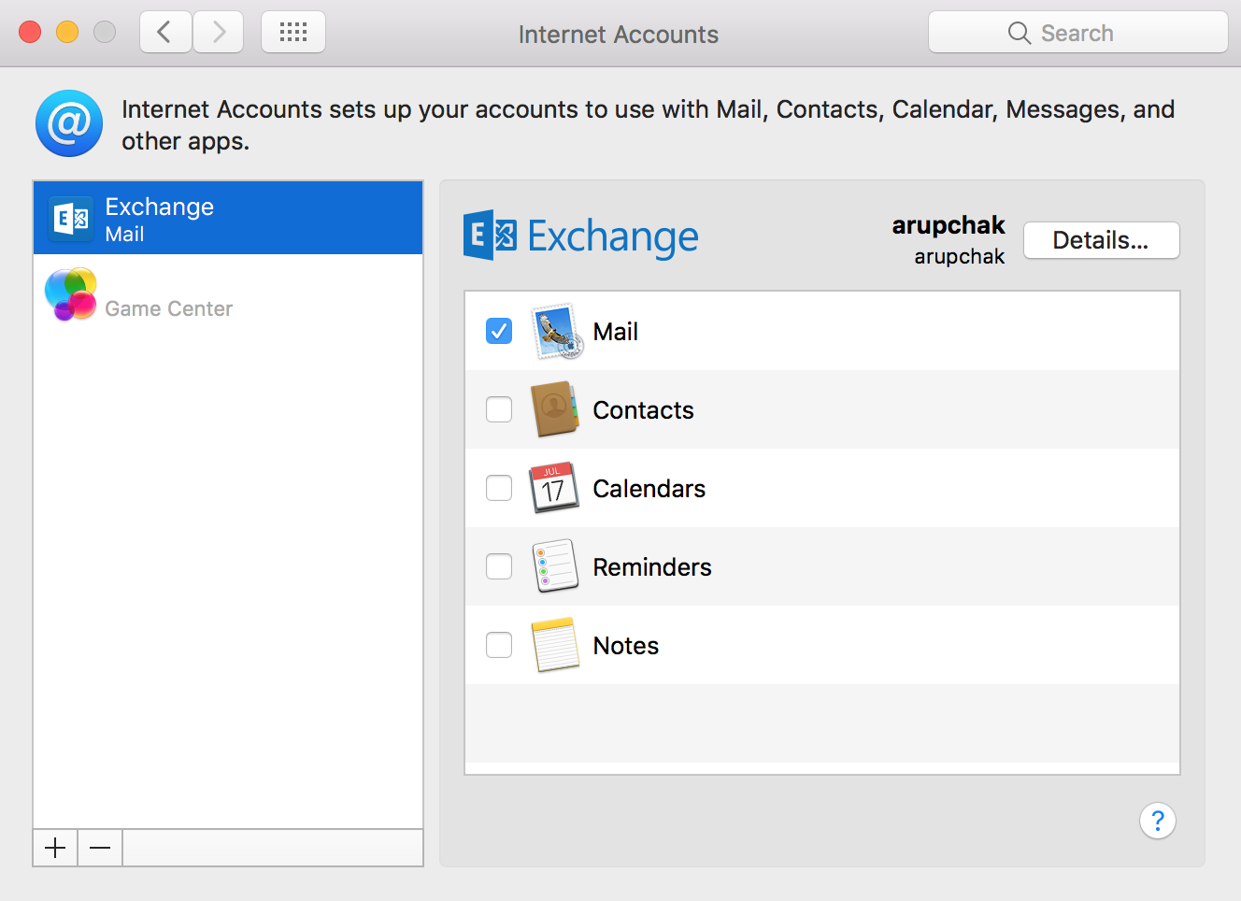
Essential Applications and Utilities
Internet Accounts
Internet Accounts tool helps to
sync the Mail, contacts, Calendars with
Mail, Address Book, iCal respectively
all together. In this place, we can
configure any exchange account
including iCloud account.
If any user gets prompt to enter
iCloud account password repeatedly,
then remove and re-add the iCloud
account here.

Slide 22
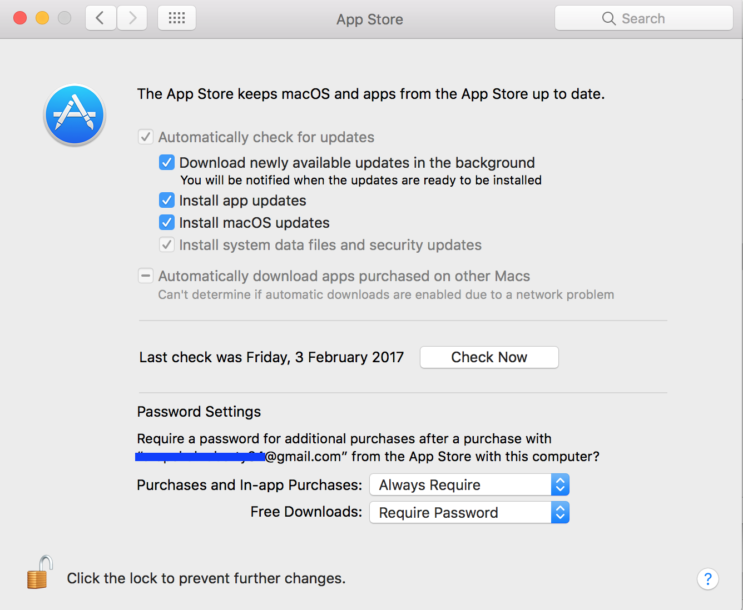
Essential Applications and Utilities
App Store
App Store is a default Application though
which we can download millions of applications
for the Mac OS. Even all the Mac OS
X and applications updates are getting
downloaded through App Store.
You can change the App store preferences
here. But if any app gets blocked during
download, then you may change the
settings under Security & Privacy section.

Slide 23
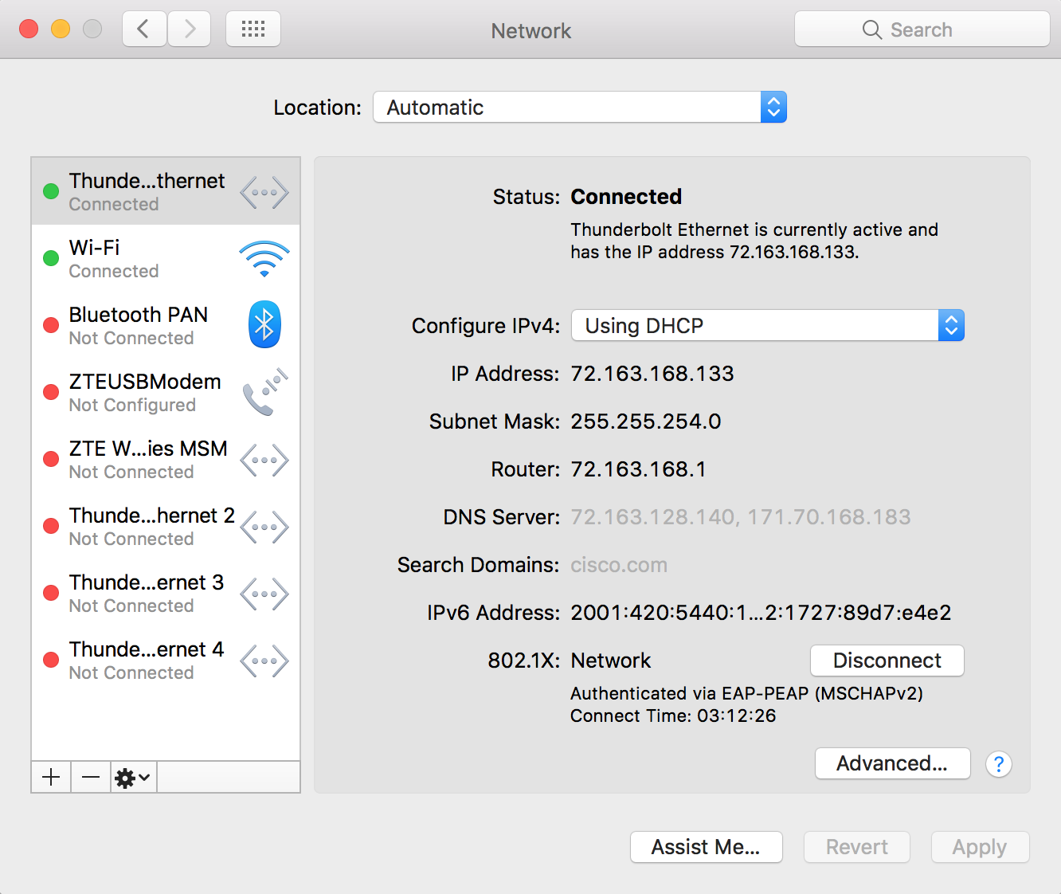
Essential Applications and Utilities
Network
Network plays a vital role on Mac OS X.
You can configure all kinds of Network devices
from here like Wi-Fi, Bluetooth based
network, USB Portable modem etc. and
even the details of configured networks
can be collected here like IP address, DNS,
domain name, etc.
If the 802.1x authentication doesn’t
work for Thunderbolt Ethernet, then
disconnect and reconnect here. You may
set the service order for all the configured
Network devices.
If there is any issue with the existing network preferences, then you may
create a new location to test the network
behavior.

Slide 24
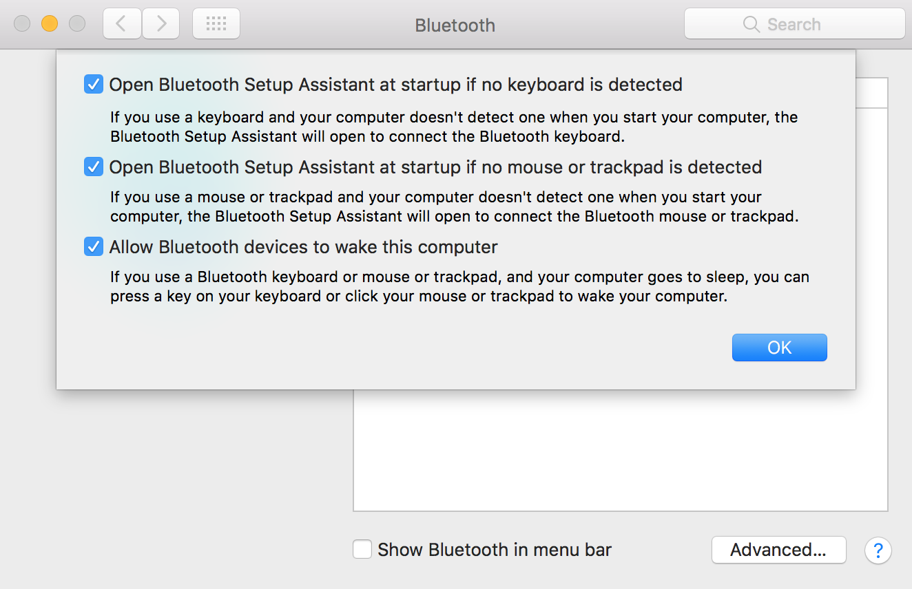
Essential Applications and Utilities
Bluetooth
Bluetooth preferences help to pair
up the Bluetooth devices like mobile
phones or computer to transfer data in
between the devices.
Even it helps to manage Bluetooth
Keyboard, Mouse and Trackpad
from the Advanced options.

Slide 25
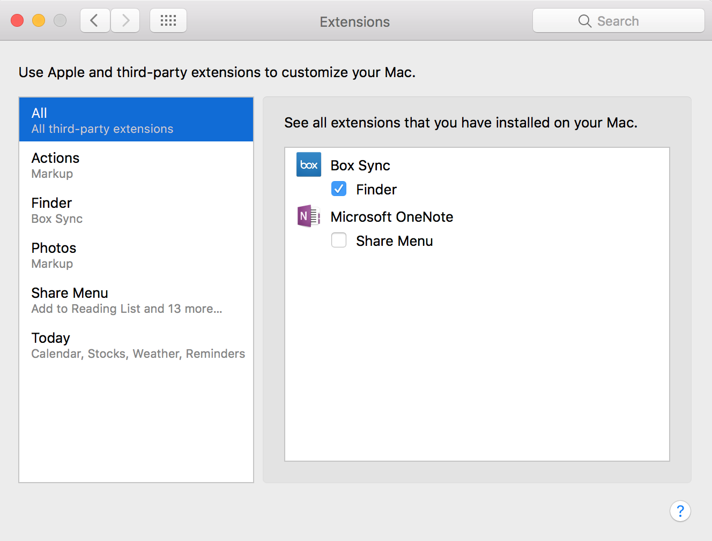
Essential Applications and Utilities
Extensions
Extensions help you to manage the
installed third-party extensions like
Box Sync, OneNote etc.
If the Box Sync or Dropbox is not
working on Finder, then make sure that
it’s enabled here.

Slide 26
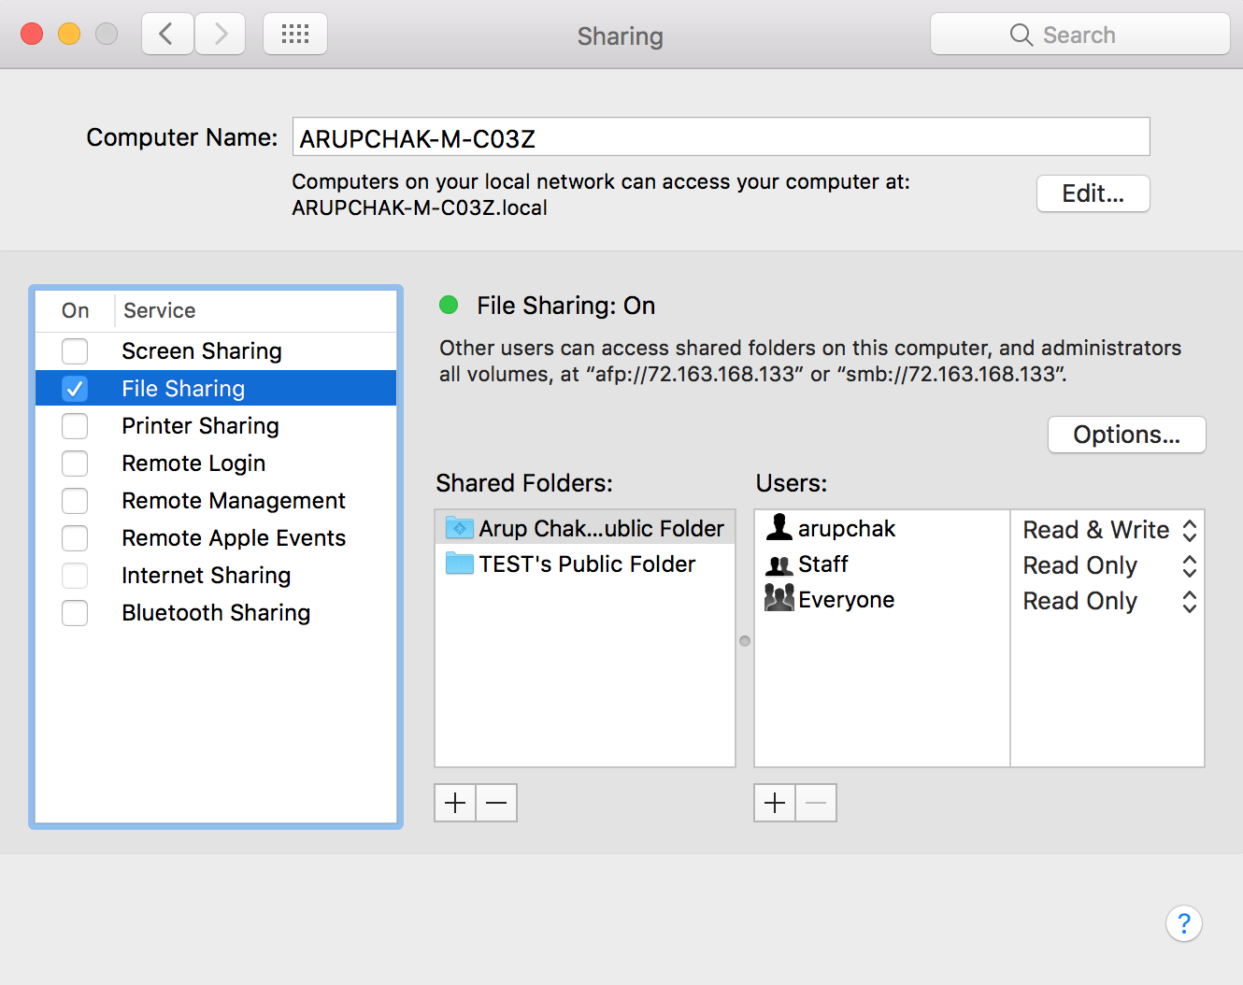
Essential Applications and Utilities
Sharing
Sharing is one the important section on Mac OS
X. Hostname can be updated here
only.
If you are unable to access a Mac through
Screen Sharing app, make sure that the
Screen Sharing box is checked.
To Share any folder on Mac, you need to add
the folder and provide permissions
accordingly and enable the File Sharing option.
NOTE: Cisco doesn’t enable this File
Sharing options by default.
You may share Internet or Bluetooth
(Tethering) from here.

Slide 27
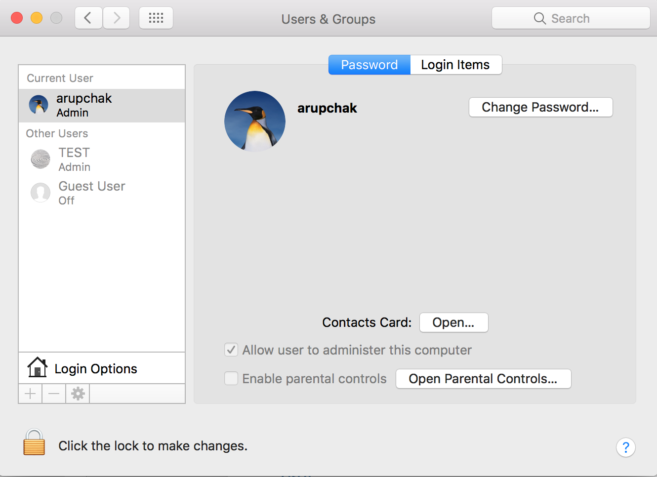
Essential Applications and Utilities
Users & Groups
Users & Groups to configure or delete user
accounts in Mac OS X. It helps you to change
password of that particular account.
There are four different kinds of users can be
created on Mac OS X; Administrator, Standard,
Sharing only, Managed with Parental Controls
account.
An administrator can create, delete, and
modify accounts; install software and change
system settings.
Standard users can install software for their
own use and change settings related to their
accounts, but can’t administer other accounts.

Slide 28
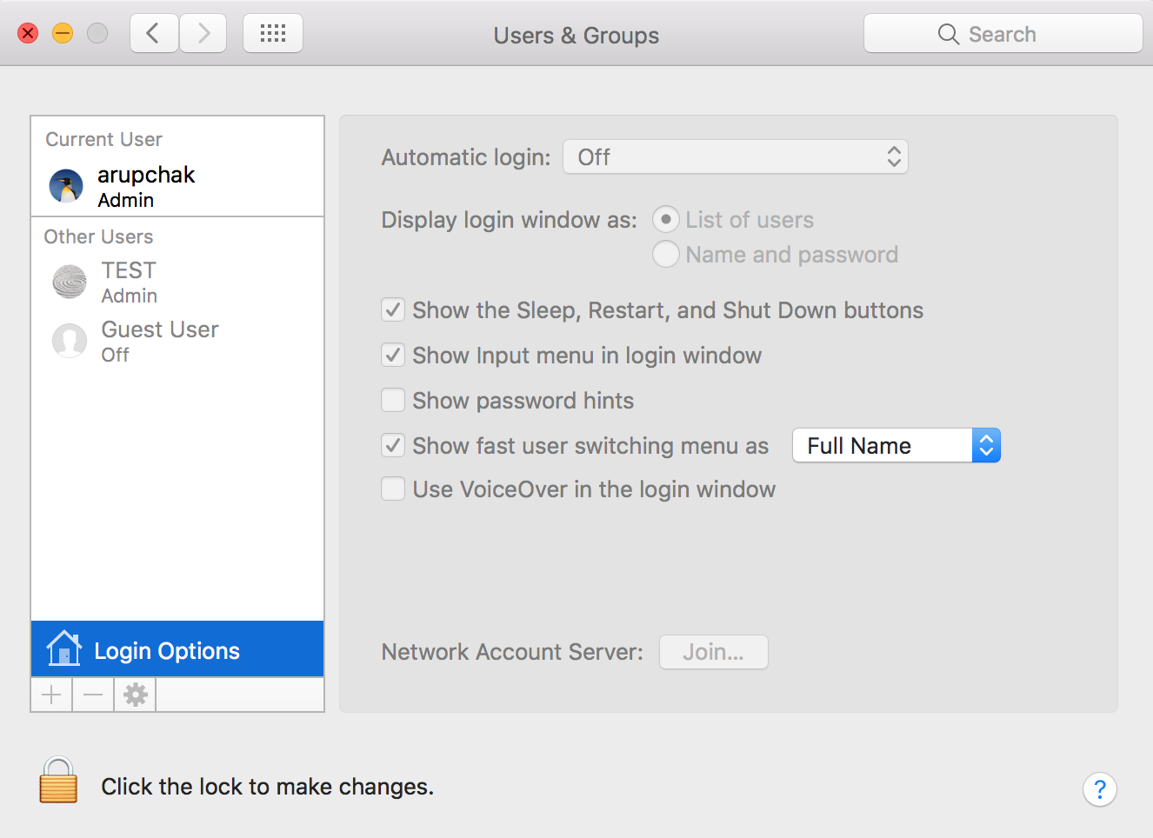
Essential Applications and Utilities
Users & Groups
Sharing-only users on your network can access
shared files remotely, but can’t log in or change
settings on the computer.
Managed with Parental Controls accounts, the
administrator can restrict access to
applications and inappropriate content, and limit the
amount of time users can use the computer.
Even you can change the login preferences and
keyboard Layout menus and join the Mac to
domain and create Root Account from Login Options.

Slide 29
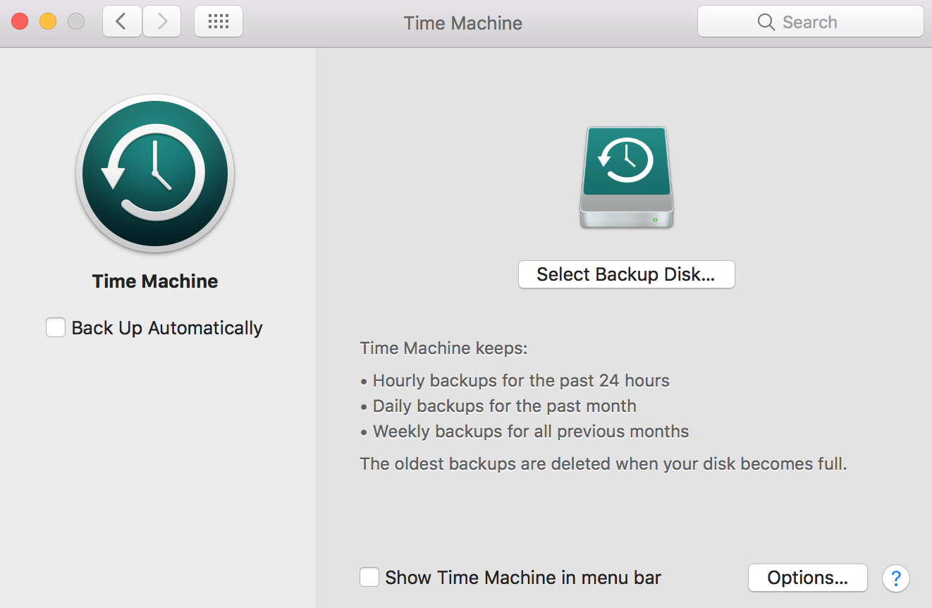
Essential Applications and Utilities
Time Machine
Time Machine option has made to setup
the Time Machine application to take an
automatic backup. Time Machine is an
application, which takes incremental
backup of the entire system including Mac
OS files. It is recommended to use the
Backup drive, which has double
capacity of the Macintosh HD
(Internal hard drive).
Also you can exclude folders or file from
the Time Machine Backup through Options.
For more information about Time Machine,
Refer: http://support.apple.com/kb/HT1427

Slide 30
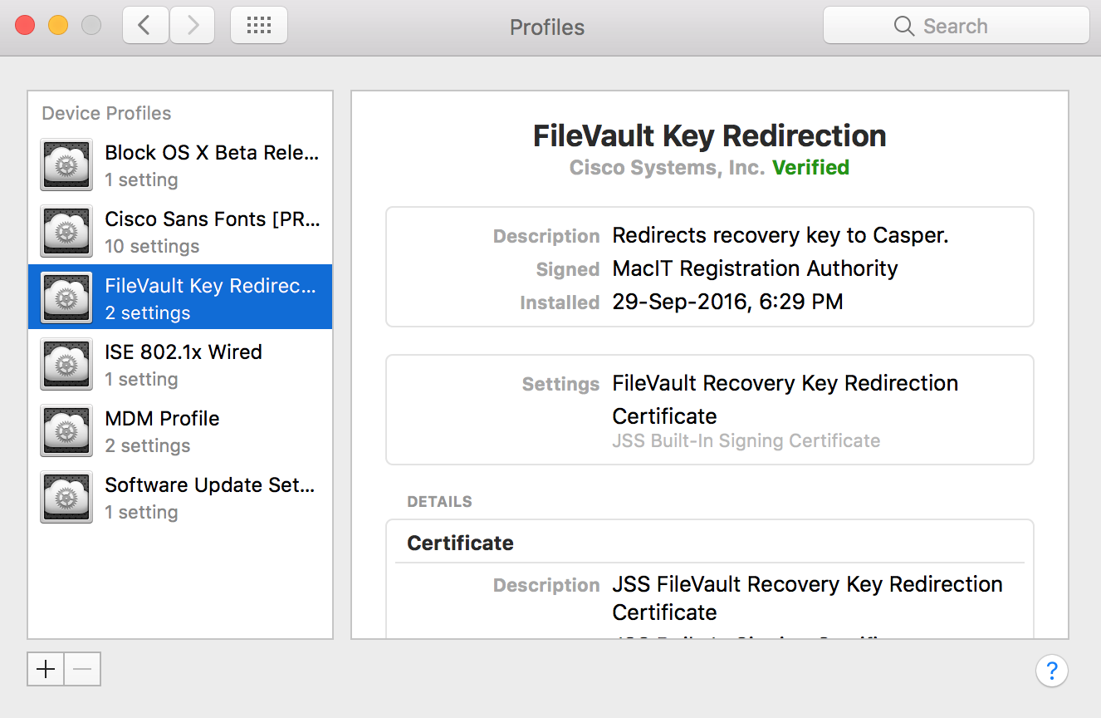
Essential Applications and Utilities
Profiles
Configuration Profiles let you standardize settings
for Mac computers. For example, an administrator
can set up profiles that configure Mac computers
to interact network through 802.1x protocol.
If there is any issue with any of the installed
profile, then we can remove it and eventually
it will get pushed again by Jamf Casper.
NOTE: Do not remove any profile from Cisco
Machine without checking with Tier 3 Engineer.
For more information, refer this article:
https://support.apple.com/kb/PH22006

Slide 31

Essential Applications and Utilities
Third-Party Plug-Ins
Third-Party Plug-Ins like Flash player, Java
get installed under the System Preferences.
You can manage the preferences of
these applications from here.

Slide 32
Essential Applications and Utilities
Network Utility
Network Utility provides a wide range of
information about your network and offers
tools to help you troubleshoot it. The utility
includes an interface for common functions
used at the command line — such as
ping, netstat, traceroute, finger, and port
scan — and the information is written out
to a text field, making it easy to copy into
email, bug reports, or other analysis tools.

Slide 33
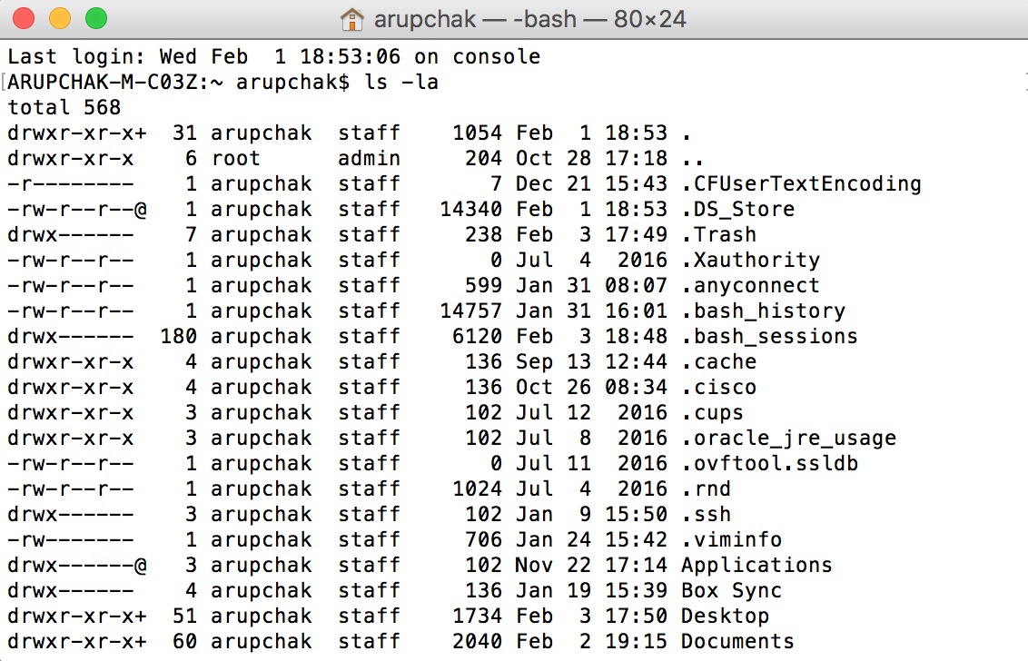
Essential Applications and Utilities
Terminal
Mac OS X is built on an industry-standard
UNIX foundation. The Terminal application
allows you to access the complete UNIX
environment using standard commands,
tools, and scripting languages. But an
incorrect command can corrupt the entire OS
or might end up loosing data.
NOTE: Please take extra caution before
running the Terminal commands.
Never use this command, “ sudo rm –rf ” if it’s
not mentioned on any article
(Apple or Cisco Jiveon)

Slide 34
Essential Applications and Utilities
Terminal Commands
Show Hidden Files:
defaults write com.apple.finder AppleShowAllFiles YES
Then Relaunch Finder
Reference url: https://cisco.jiveon.com/docs/DOC-931775
NOTE: You can type “NO“ instead of YES and then relaunch the Finder to Hide the hidden file
Reset System Core services:
/System/Library/Frameworks/CoreServices.framework/Versions/A/Frameworks/LaunchServices.framework/Versions/A/Support/lsregister -kill -r
Uninstallation of Casper or un-enroll a Mac from Casper: sudo jamf removeFramework

Slide 35
Essential Applications and Utilities
Terminal Commands
What is does? | Terminal Command
Clear the content on Terminal Window | clear
To navigate to a particular folder | Cd <followed by path>
List the contents of a Directory | ls
To view it in a list format | ls -l
To view all network adapter details including IP | ifconfig

Slide 36
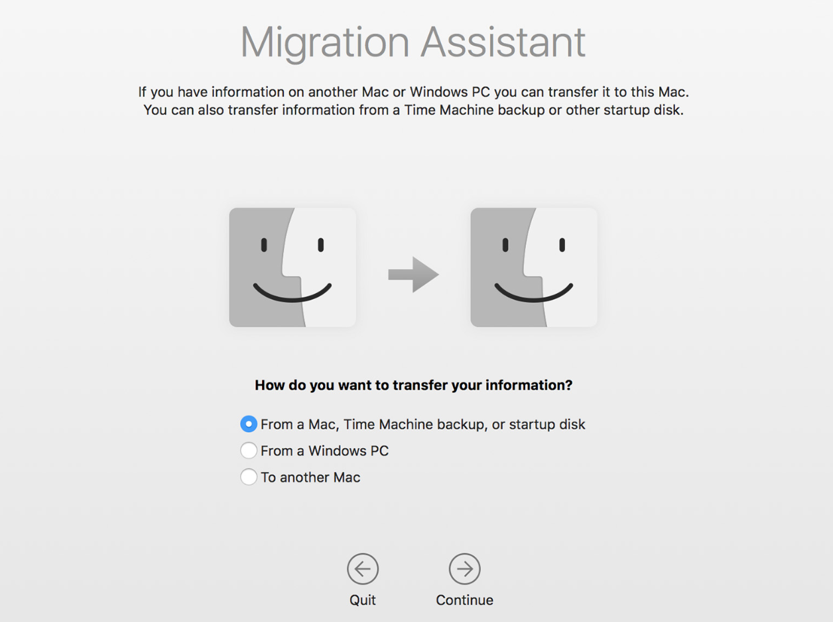
Essential Applications and Utilities
Migration Assistant
Migration Assistant simplifies the process of moving your information from a Mac or Windows computer to another Mac by transferring User’s Data including documents, music, photos, applications, network settings, and other preferences. Simply connect the two Mac computers using a FireWire or Ethernet cable. If you use Time Machine, you can transfer files from your backup copies by connecting your Time Machine backup drive via USB or wirelessly using Time Capsule. And transferring files from a Windows computer to a Mac is just as easy.
For more information, refer https://support.apple.com/en-in/HT204350

Slide 37
Essential Applications and Utilities
Migration Assistant
While Migrating the data from Old Mac to new Mac, I would recommend not to select
Applications and Computer & Network Settings as most of times, these contents would have
the corrupted data. But in this case, user have to install all Applications one by one, which is
time consuming.
For some reason, if Migration Assistant doesn’t work or fails during the process, then you
may put the old Mac in Target Disk Mode by pressing and holding down “ T “ key at startup.
Then connect the Hardwire or Thunderbolt cable between the Macs and the old or source
Mac will appear as an external volume on the new Mac desktop. User can copy the
required data from old machine to new Machine manually by entering the old Mac password
to unlock it.
Reference URL: https://cisco.jiveon.com/docs/DOC-997781

Slide 38
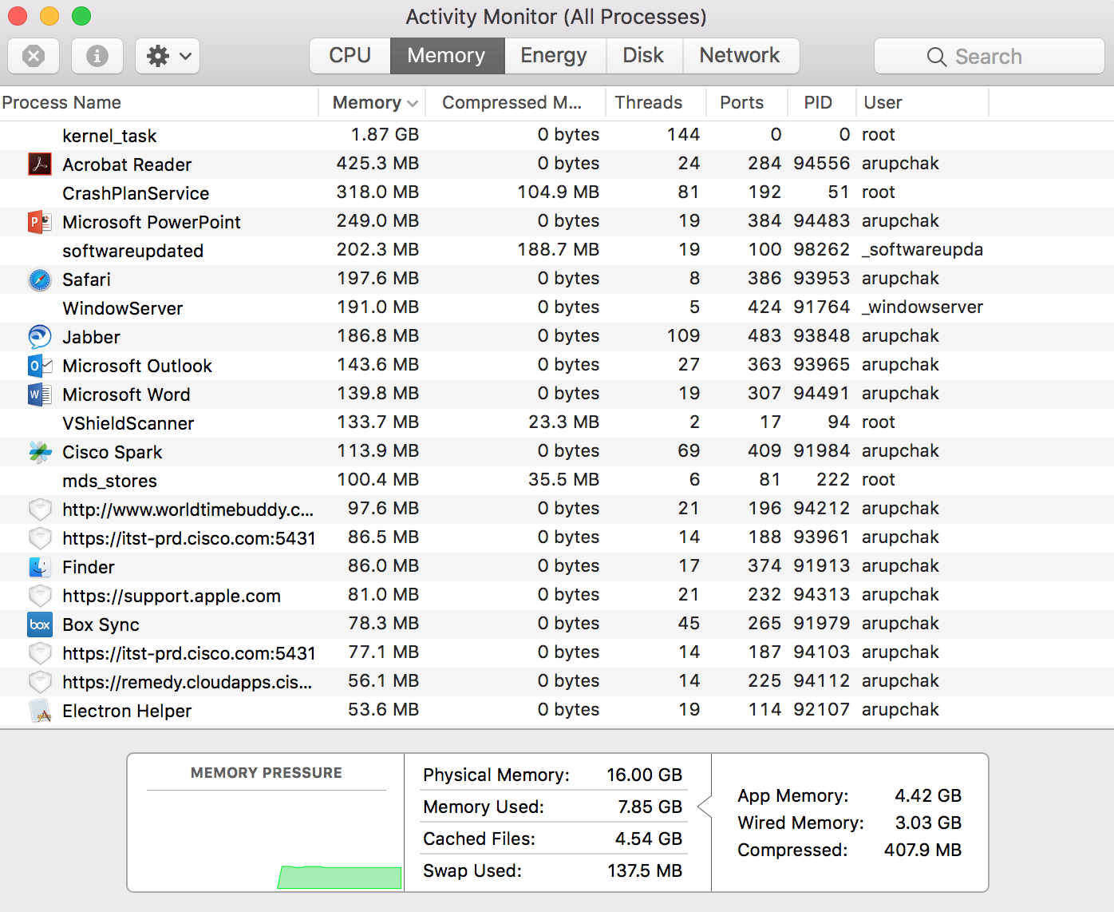
Essential Applications and Utilities
Activity Monitor
Activity Monitor displays information about
all the processes running on your Mac,
including CPU, disk, memory, and network usage.
You can see exactly how your computer’s
resources are being used via a searchable table,
helpful graphs, or even directly in the Dock icon.
You can view the processes organized in
different groupings, quickly search for processes,
and quit processes. Activity Monitor also makes it
easy to see how your memory is being used
and how much memory is available, as well as
disk activity and data transferred over the network.

Slide 39
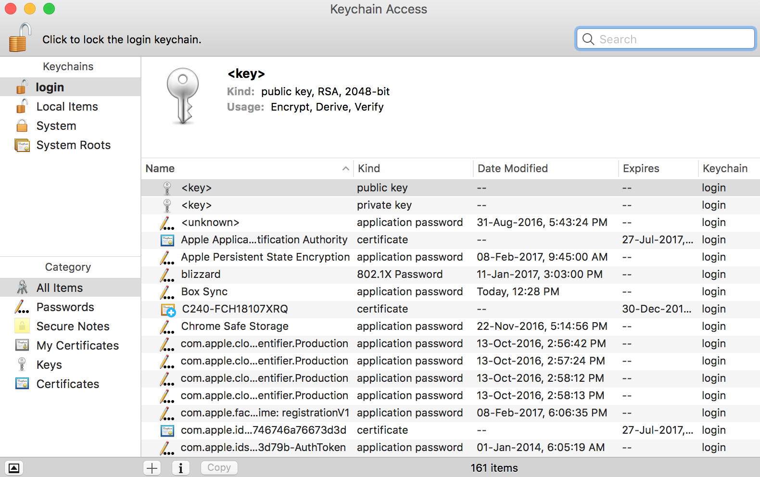
Essential Applications and Utilities
Keychain Access
Keychain Access is password management
system in Mac OS X. It allows the user to access the
Keychain and configure its contents, including
passwords for websites, web forms, FTP servers,
SSH accounts, network shares, wireless networks,
groupware applications, encrypted disk images, etc.
It unlocks, locks, and displays passwords saved by
the system which are dynamically linked to the
user's login password, as well as managing root
certificates, keys, and secure notes. Its graphical
user interface displays various keychains, with there
usually being at least two: the login keychain and the
system keychain. The default keychain file is the
login keychain, typically unlocked on login by the
user's login password.
Keychain files are stored in: ~/Library/Keychains/
/Library/Keychains/

Slide 40
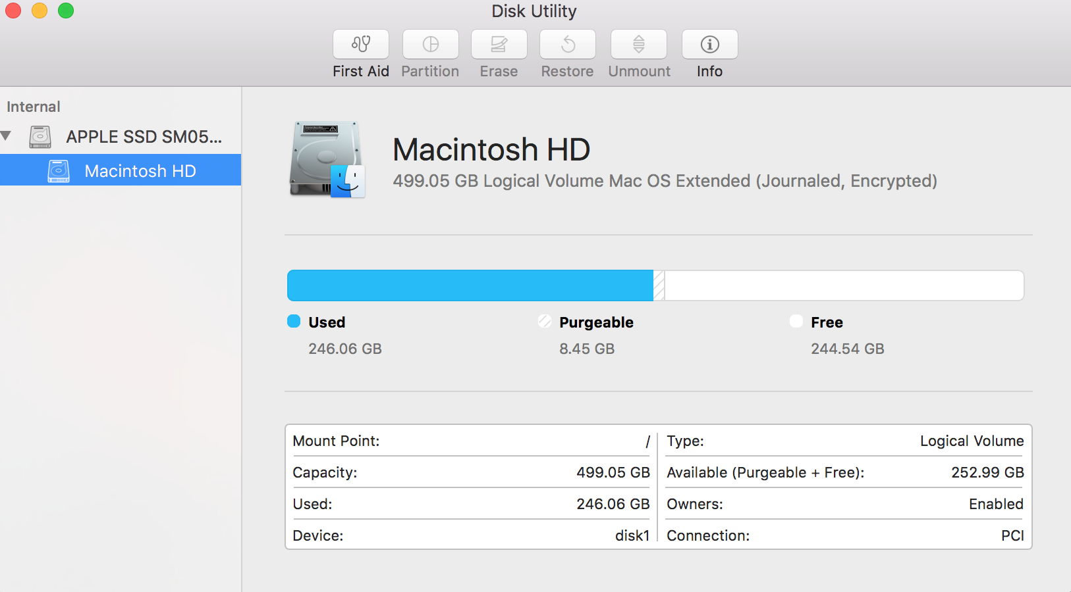
Essential Applications and Utilities
Disk Utility
Disk Utility is a powerful application for
viewing, managing, and troubleshooting the
disks connected to your Mac, including
internal and external hard drives, disk
images, CDs, and DVDs. With Disk Utility,
you can verify the integrity of a disk, repair
it, securely erase it, and partition a hard
drive. You can also create secure disk
images for storing important files using
AES 128- or 256-bit encryption.
For more information about verifying and
repair disk, refer
http://support.apple.com/kb/HT1782

Slide 41
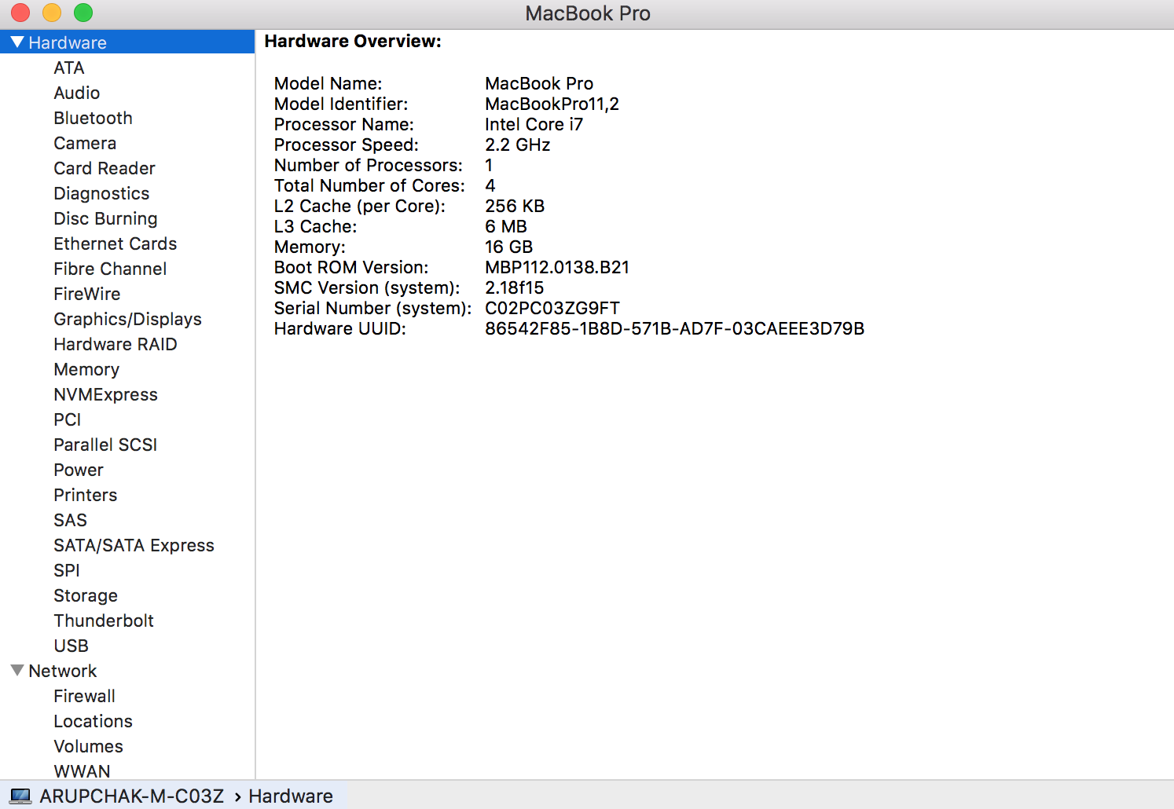
Essential Applications and Utilities
System Information
System Information provides detailed
information about your computer’s hardware,
software, and network including computer’s
hostname in an easy-to-read layout. It’s perfect
for checking to see if your Mac meets the
requirements for a new hardware or software
product and for confirming that the particular
hardware has detected or available on your
Mac. You can save your profile or have it
sent directly to Apple Support.
You may also access System Information from
Apple Logo < About this Mac

Slide 42
Essential Applications and Utilities
XQuartz
XQuartz is a open source utility which is required for Softoken II application. It can be
downloaded from here: https://www.xquartz.org
If there is any issue with XQuartz utility, then you may uninstall it by running these commands
on Terminal window.
launchctl unload /Library/LaunchAgents/org.macosforge.xquartz.startx.plist
sudo launchctl unload /Library/LaunchDaemons/org.macosforge.xquartz.privileged_startx.plist
sudo rm -rf /opt/X11* /Library/Launch*/org.macosforge.xquartz.* /Applications/Utilities/XQuartz.app
/etc/*paths.d/*Xquartz
sudo pkgutil --forget org.macosforge.xquartz.pkg
You may also refer this link (Manually uninstall XQuartz X11 step by step) :
https://www.uninstallmacapp.com/xquartz-x11-removal.html

Slide 43
Essential Applications and Utilities
MS Office 2016
MS Office 2016 comes up with bundled applications as Word, Excel, Power Point, OneNote and
Outlook. Outlook is an application where E-mail, Calendars, Contacts, Tasks, Notes features are integrated
on a single platform. Also there is a Propose New Time feature, the ability to see calendars side by side,
and a weather forecast in the calendar view of Outlook.
Outlook 2016 can efficiently handle large amount of data without any issues. This is being used in
Cisco as e-mail clients on both Mac and Windows platforms. For creating a Outlook 2016
Profile on Mac, refer: Outlook 2016 MAC
You may also follow this article, Email Account to remove and re-add the Cisco Exchange account on Outlook 2016.
In Word, there is a new Design tab, an Insights feature, which is powered by Bing, and real-time
co-authoring. In Excel, there is a Recommended Charts feature, and PivotTable Slicers. In PowerPoint,
there are theme variants, which provide different color schemes for a theme.
For more information about Outlook, refer: Email and Calendaring Services
Notes:
New profile and migrate local data from previous file:
https://apps.na.collabserv.com/wikis/home?lang=enus#!/wiki/W0e98eb7d8e03_4814_abb5_5694ca81c561/page/How%20can%20I%20add%20a%20new%20profile%20and%20migrate%20local%20data%20from%20a%20previous%20profile
Completely remove and read email account and profile:
https://apps.na.collabserv.com/wikis/home?lang=en-us#!/wiki/W0e98eb7d8e03_4814_abb5_5694ca81c561/page/How%20can%20I%20completely%20remove%20and%20re-add%20my%20email%20account%20and%20profile
Outlook: https://apps.na.collabserv.com/wikis/home?lang=en-us#!/wiki/W0e98eb7d8e03_4814_abb5_5694ca81c561/page/Outlook%202016%20Mac

Slide 44
Essential Applications and Utilities
Cisco AnyConnect
Cisco AnyConnect is the application which helps to setup the VPN on external network. Now supports
2 profiles, which will use a different protocol for their connections. When opening the drop down
menu to choose a connection you should see each of the 14 global sites listed twice as "Site - SSL"
and "Site - IPSec". If the client only shows one type of connection you can reinstall the client from
the standard setup instructions which will install both profiles along with the latest version of AnyConnect
available from IT. Some users may find that one profile (CRDC, if they have configured separately) or
the other works better on a particular network, and some customer sites Firewall rules may only
allow one type of connection. There are no restrictions from the Cisco side on which profile the
users\ select. They are free to use whichever works best for their setup.
For more information please refer:
https://apps.na.collabserv.com/wikis/home?lang=en-us#!/wiki/Wadedadedb802_4c25_b220_97754521da15/page/AnyConnect%20Self-Help

Slide 45
Essential Applications and Utilities
Softoken II & MobilePASS
Softoken II and MobilePASS are the two different methods to generate passcode to establish VPN
connection through Cisco AnyConnect application. Softoken II has a dependency on XQuartz (X11)
application as it helps to initialize the Softoken II during rekey process. If XQuartz is not up to date or it has
some issue; then it won’t pop-up the new PIN window while reinitializing the token file on Softoken II. If
Softoken II doesn't reinitialize after multiple attempts even though XQuartz, then help the user to migrate
to MobilePASS. For more information, refer Softoken Initialize
MobilePASS applications can be downloaded from App Store on Mac or on any Android/iOS devices.
Then order “Convert Token Type” from Cisco eStore and convert to MobilePASS and follow the instructions
to activate it. You may even order “Reactivate MobilePASS” to recreate the token based passcode.
For more information, refer MobilePass
NOTE: Make sure that user enters the MobilePASS pin carefully as it jumps to the next screen as
soon as user’s enters the 8th character and there is no option to correct it after typing the 8th character.
Notes:
SofToken Initialize Steps for PC refresh users MAC:
https://apps.na.collabserv.com/wikis/home?lang=en-us#!/wiki/W86134cdf40f4_4db8_bcd0_c8475620ede3/page/SofToken%20Initialize%20Steps%20for%20PC%20refresh%20users%20MAC
https://apps.na.collabserv.com/wikis/home?lang=en-us#!/wiki/Wcec08bbcdf89_4178_a2bc_6dcca91532b4/page/Activate%20%20Reactivate%20MobilePass

Slide 46
Essential Applications and Utilities
VMware Fusion
VMware Fusion helps to virtualize Windows 10 on Mac OS X to access all Windows based applications
and files.
To view or access the installed virtual machines, launch VMware Fusion application and then from
the menu bar, click on Windows < Virtual Machine Library.
You can follow this article: VMware to setup Windows 10 VM on
Mac OS X.
NOTE: Do not use Google Chrome to download the Versioned.UEFI.OSD.2016-05-05.iso file or
Windows 10 x64.ova template.
If there is any issue with VMware Fusion, then follow this article: Uninstallation guide to uninstall VMware
Fusion completely from Mac OS X.
Notes:
Vmware set up link: https://apps.na.collabserv.com/wikis/home?lang=en-us#!/wiki/Wd6e509e5a3ee_4b03_9927_3d234e618feb/page/Computer%20Setup%20Options%20Windows%2010%20VM

Slide 47
Essential Applications and Utilities
McAfee & FireAmp
FireAmp is another Cisco approved security application apart from McAfee. It’s not
recommended to install on each and every Mac. During the pilot project, Cisco has installed
FireAmp for set of Mac users. If any Mac has FireAmp by default, then there is no need of
McAfee on that Mac as it’s approved from Cisco.
NOTE: If Mac has any issue related to FireAmp, like FireAmp process is utilizing the
resources more than 80% or 90%, then escalate those cases to Desktop T3 Mac.

Slide 48
Essential Applications and Utilities
McAfee & FireAmp
McAfee is the default antivirus for all Windows and Mac computers in Cisco. The main
products are VirusScan Enterprise and Endpoint Security. VirusScan and Endpoint Security
both provides continual scanning and removal of malicious computer virus infections, worms and
spyware to cover a broad range of threats. For more information, refer McAfee Endpoint security
If there is any issue with McAfee Endpoint Security, then you can uninstall it from Mac OS X by
running the following commands on Terminal.
sudo /usr/local/McAfee/uninstall.sh
sudo /usr/local/McAfee/uninstallCleanup.sh
Once it’s uninstalled, then restart the Mac and download McAfee Endpoint Security from eStore and
install it back.
NOTE: If the issue still persists, then escalate the case to Enduser Computing Mac

Slide 49
Essential Applications and Utilities
CrashPlan
CrashPlan is the new desktop backup solution for Windows and Mac at Cisco. CrashPlan runs on
Cisco technology and utilizes modern scale-out architecture to allow solution growth in line with the
changing size of the business. Backup data is retained for 60 days following the existing Backup Data
retention policy (that can be found in IT Policy Central) and continues to enforce the file exclusion policy
that HP-Connected had in place plus a few more Vendor (Code42) recommended exclusions. The
exclusions are primarily system / OS related files and other files such as VMDKs.
For more information, refer CrashPlan overview
You may manage all the devices on CrashPlan Management console:
https://crashplan.cisco.com:4285
If there is any issue with Crahsplan, then uninstall it by running Uninstall.app from
/Macintosh HD/Library/Application Support/Crashplan. Once it’s uninstalled, then restart the Mac
and run this command on Terminal while the Mac is connected to Cisco Network.
sudo jamf policy -event givemeproe
NOTE: If the issue still persists, then escalate to Crashplan support team.
Notes:
CrashPlan Overview: https://cisco.service-now.com/sp?id=kb_article&sys_id=add798e9dbbe53403e0d5678dc96199f

Slide 50
Essential Applications and Utilities
Mac Setup Assistant (CUSA)
Cisco Unified Setup Assistant (CUSA) for Mac aims to dramatically simplify computer setup at
Cisco by consolidating and automating what was once a disjointed and prolonged manual process.
The new Unified Setup Assistant installs and launches automatically once a Windows computer has been
re-imaged or a Mac computer has enrolled into casper.cisco.com. This new Setup Assistant
supersedes existing legacy applications with which you may be familiar, including the Legacy PC and
Mac Setup Assistants and will minimize clicks involved to setup and make both setups very
similar with only basic differences.
Reference Link:
http://helpzone.cisco.com/t5/System-Setup-Protection/Cisco-Unified-Setup-Assistant-CUSA-for-Mac-Support-Information/ta-p/17303

Slide 51
Essential Applications and Utilities
OnRamp
OnRamp provides a central access point to request accounts for and administer access to various
types of user access tools. OnRamp requires your CEC authentication twice. If you use "remember
password" browser feature, and you make a password mistake - OnRamp might get stuck with incorrect
password. In this case, launch Keychain Access and click on Password on the left pane and search for the
entries with CEC ID (for example: abcdefg@cisco.com) and delete all the entries and also clear all the
browsers’ Caches and Cookies.
NOTE: Do not delete any other credentials from Keychain Access as it may cause other issues while
accessing the third-party webpages or applications.
*** If the issue still persist with OnRamp, then escalate the case to OnRamp Support Team.
To check your current permissions list use the following link:
http://eman-core.cisco.com/SERVICE/OnRamp/status/CEC Username

Slide 52

Troubleshooting of Mac OS X & Applications
Notes:
Replace ‘Application Name’ in the Title with the actual Application or Service Name. The quotes can be removed also.

Slide 53
Troubleshooting
Mac OS X Startup Issues
PRAM & SMC
Mac OS X Troubleshooting
Mac OS X Inbuilt Application
Mac OS X Supported Apps
Notes:
List the scope of support for the Employee Services Technical Support team, which includes support expectations.
Provide a brief support model description for the new tool/application being presented in this slide deck.
If this training is specific to an upgrade, provide a brief current support model description and include the upgrade details. Ie: new features or functions, etc.

Slide 54
Mac OS X Startup Issues
On a Mac, sometimes we get Startup Issues like:
- Grey Screen
- Prohibitory Sign
- Flashing Question Mark
- Broken Folder
- Apple Logo with Spinning Gear
Sometimes the Mac gets stuck at startup with any of the above symptom. To fix that issues, try the following troubleshooting steps:
Perform a PRAM Reset.
NOTE: To perform a PRAM Reset, press and hold down, COMMAND + OPTION + P + R keys together and then turn ON the Mac. The Mac would get restarted again and again. Release those key after the third Chime. For the Desktop, which has Bluetooth Keyboard, try the same procedure immediately after turning ON the Mac.
For more information about PRAM, refer http://support.apple.com/kb/HT1379

Slide 55
Mac OS X Startup Issues
If the issue still persists, then hold down the ‘OPTION’ key at startup and then turn ON the Mac. Select the bootable partition (Macintosh HD) and then click on the arrow mark on the bottom to boot through that partition.
If the issue still persists, hold down the ‘SHIFT’ key and then turn ON the Mac and don’t leave the ‘SHIFT’ key until it shows the login screen. It would help the Mac to boot to Safe boot, which would take approximately, 3 – 5 minutes and also it would show a progress bar on the grey screen.
NOTE: If the Mac fails to boot to Safe boot, then we have only option to reinstall the Mac OS X and restore the data from Time Machine backup or from CrashPlan Backup.
If it boots to Safe boot, clear the contents from following Locations:
Macintosh HD/Library/Caches/
Macintosh HD/Library/Startupitems/
Macintosh HD/Users/<User’s Home Folder>/Library/Caches/
Macintosh HD/Users /<User’s Home Folder >/Library/Cookies/
Macintosh HD/Applications/System Preferences/Users & Groups/Login items

Slide 56
Mac OS X Startup Issues
To delete Login items, open the Lock on the bottom left corner using the Administrator Username and Password and then highlight the user account on the left hand side and select ‘Login Items’ on the right side.
Delete all the items(except CrashPlan) listed under Login Items by highlighting one by one and clicking on the (-) sign. Empty the Trash by right clicking on Trash icon on the Dock. If some of the files are not deleting, then you can delete those after rebooting the Mac by next time.
Then Perform First Aid from the Disk Utility Window by selecting the Macintosh HD on the left side.
Now Go to System Preferences < Startup Disk, select Macintosh HD and click on Restart.
If the issue still persists, then boot to safe boot again and backup the user data.
Once the User data has backed up, then restart the Mac.
Boot through the Mac OS install Disk or the Recovery HD
Then Launch Disk Utility and perform First Aid by selecting the Macintosh HD.
If the First Aid has completed successfully, then restart the Mac and check the status.
If the issue still persists or if the First Aid has failed, then format the entire Macintosh HD and reinstall the operating System by following this article: Mac OS Set up
NOTE: If the Mac gets stuck at Blue screen, then follow the steps from (ii) to (x).
For more information about the Startup issues, refer https://support.apple.com/en-us/HT204156

Slide 57
When to Perform PRAM
PRAM is "non-volatile random-access memory," a small amount of your computer’s memory that stores
certain settings in a location that macOS can access quickly. The settings that are stored in NVRAM depend
on the type of Mac you're using and the types of devices connected to it. Information stored in NVRAM can
include:
Speaker volume
Screen resolution
Startup disk selection
Recent kernel panic information, if any

Slide 58
When to Perform SMC
The computer fans run at high speed, though the computer isn't experiencing heavy usage and is properly
ventilated.
The keyboard backlight behaves incorrectly.
The status indicator light (SIL) behaves incorrectly.
Battery indicator lights, if present, behave incorrectly on Mac notebooks that have a non-removable battery.
The display backlight doesn't respond correctly to ambient light changes.
The computer doesn't respond to the power button when pressed.
A Mac notebook computer doesn't respond properly when you close or open the lid.
The computer sleeps or shuts down unexpectedly.
The battery doesn't charge properly.
The MagSafe power adapter LED doesn't indicate the correct activity.
The computer is performing unusually slowly, though it isn't experiencing abnormally high CPU utilization.
Application icons bounce in the Dock for an extended amount of time when opened.
Applications don't function correctly, or they stop responding after being opened.
A computer that supports target display mode doesn't switch into or out of target display mode as
expected, or it switches into or out of target display mode at unexpected times.
The illumination around the I/O ports on a Mac Pro (Late 2013) doesn't activate when you move the
computer.

Slide 59
Isolating Hardware Issues
Audio
If there is no Audio output, then follow the below troubleshooting steps to isolate the hardware issue:
Check the Volume and make sure that it’s not in Mute position
Check for the Startup Chime, if the Chime comes up at startup, then there is no hardware issue with the
Internal Speaker.
If the startup Chime doesn’t come up, even though the volume level is in maximum position then there
is a hardware issue with the Internal Speaker.
If the Startup Chime comes up, but there is no Audio output from any application, then check the
output settings in Macintosh HD\Applications\System Preferences\Sound\Output\
If the output settings shows perfect, then try connecting any external speaker and check
If the Audio output comes up through External Speaker, then there is a hardware issue with the Audio
In/Out port.

Slide 60
Isolating Hardware Issues
Thunderbolt Ethernet
If the network is not working through the Thunderbolt Ethernet Port, then follow the below steps to isolate the
hardware issue:
Try connecting the cable to a different thunderbolt port. Also check the Ethernet Cable and thunderbolt
adapter and make sure that it’s working fine. Also check the connectivity of the wall port.
Check in Macintosh HD\Applications\System Preferences\Network\Thunderbolt Ethernet and make sure
that it obtains a valid IP address. If it’s showing a valid IP address, then check the DNS Servers,
Proxy settings, if there is anything entered manually as it comes from DHCP server by default.
If it’s not showing up any valid IP address, then restart the Mac and boot through the Recovery HD and
launch Network utility from the Utilities Menu bar. Select the Interface as Thunderbolt Ethernet under Info
Tab.
If the Link Status shows Inactive, then there is hardware issue with the Network Interface Card.
If the Link status shows Active with an invalid IP address, then there is an issue with the wall port or
cable or adapter.
If the Link status shows Active with a valid IP address, then go to Ping tab and type www.google.com
and try to ping to the Google server.
d)If the Ping has completed successfully, then there is an issue with the Mac OS
e)If the ping hasn’t completed, then there is an issue with Switch Settings.

Slide 61
Isolating Hardware Issues
Thunderbolt Ethernet
If the issue has been isolated as a Mac OS X related issue, then restart the Mac.
Go to Macintosh HD\Applications\System Preferences\Network\ and open the Lock from the bottom left
corner of that page by entering the Administrator Username and Password.
Then Select Edit Location from the Location Drop down Menu. Add a new Location, by clicking on the
(+) button and then click on Done. Click on Apply on the bottom right corner.
Disconnect the Thunderbolt Network adapter and go to Keychain Access
Search for the entries with Network or Default or 802.1x and delete all the entries
Now connect the thunderbolt Ethernet cable and authenticate with Cisco CEC ID and password.
If you get the IP valid address with 802.1x authentication enabled, but still unable to browse, then download
and run Malwarebytes to scan for Malware or adware from this link:
https://www.malwarebytes.com/antimalware/mac/
NOTE: Make sure that you have uninstalled it after running the scan.

Slide 62
Isolating Hardware Issues
Wireless
If the network is not working through the Wi-Fi Port, then follow the below troubleshooting steps to isolate the
hardware issue:
Check the Airport or Wi-Fi icon and make sure that it’s turned On and also check with other wireless
network to confirm whether the Wi-Fi is working or not.
Check in Macintosh HD\Applications\System Preferences\Network\Wi-Fi\Advanced\TCP/IP\ and make
sure that it obtains a valid IP address. If it’s showing a valid IP address, then check the DNS Servers,
Proxy settings, if there is anything entered manually as it comes from DHCP server by default.
If it’s not showing up any valid IP address, then restart the Mac and boot through the Recovery HD.
Then launch Network utility from the Utilities Menu bar. Select the Interface as Wi-Fi under Info Tab.
If the Link Status shows Inactive, then there is a hardware issue with the Airport Card.
b) If the Link status shows Active with an invalid IP address, then there is an issue with the blizzard
wireless.
c) If the Link status shows Active with a valid IP address, then go to Ping tab and type www.google.com
and try to ping to the Google server.
d) If the Ping has completed successfully, then there is an issue with the Mac OS X.
e) If the ping hasn’t completed, then there is an issue with blizzard wireless.

Slide 63
Isolating Hardware Issues
Wireless
If the issue has been isolated as a Mac OS X related issue, then restart the Mac.
Go to Macintosh HD\Applications\System Preferences\Network\ and open the Lock from the bottom
left corner of that page by entering the Administrator Username and Password. Then Select
Edit Location from the Location Drop down Menu and add a new Location, by clicking on the (+) button and
then click on Done.
Then Click on Apply on the bottom right corner.
Turn off Wi-Fi and go to Keychain Access.
Search for the entries with Network or Blizzard or 802.1x and delete all the entries.
Now connect the thunderbolt Ethernet cable and authenticate with Cisco CEC ID and password.
If you get the IP valid address with 802.1x authentication enabled, but still unable to browse,
then download and run Malwarebytes to scan for Malware or adware from this link:
https://www.malwarebytes.com/antimalware/mac/
Reference Link: Wi-Fi TBS MAC
NOTE: Make sure that you have uninstalled it after running the scan.

Slide 64
Isolating Hardware Issues
Display
If there is an issue with the Display (No Display, Distorted Display, Lines on the Display), then follow the below
troubleshooting steps to isolate the hardware issue:
Make sure that the Mac is turned ON and check for the startup Chime.
Hold down the OPTION key at startup and check whether it shows any bootable drive or not in Startup
Manager.
If it doesn’t show anything, then there is a hardware issue with the display
If the Display has any distortion at startup Manager, then it’s an issue with the Display
For better isolation, boot through the Recovery and then check the display. If the issue persists, then there is
a display issue. If the issue doesn’t get reproduced there, then it’s an issue with the Mac OS X.

Slide 65
Isolating Hardware Issues
Keyboard & Mouse
If there is an issue with the Keyboard or Mouse, then follow the below troubleshooting steps to isolate the
hardware issue:
Make sure that the Keyboard/Mouse has connected Properly.
For Bluetooth Keyboard, replace the battery and then pair up the keyboard/Mouse.
For better isolation, boot through the Recovery HD
Launch Network Utility and go to Ping tab and check the Keyboard/Mouse.
If it’s working fine over there, then it’s an issue with the Mac OS X.
If it’s not working over there, then it’s an issue with the Keyboard/Mouse.

Slide 66
Isolating Hardware Issues
Printer
If a printer is not working as expected, then follow the below troubleshooting steps to fix the issue:
Make sure that the printer is connected to a power source and Turned ON (for local Printers)
and check the other connections of the Printer to Mac.
For domain printer, check the printer by going to print.cisco.com and ping to the printer by typing
printer-xxxxxx
Try with a different printing application like MS Word or Safari or Text Edit, other than the effected one.
If the printer works fine with the other applications, then troubleshoot that particular application.
If the printer in still not working or print goes to the printer; but doesn’t print; then check if there is
Print Audit 6 application is installed on the Mac OS X.
If Print Audit 6 installed, then run the Print Audit uninstaller to remove it completely.
Make sure that there is no traces of Print Audit on the following locations:
~/Library/LaunchAgents/
/Library/LaunchAgents/
/Library/LaunchDaemons/

Slide 67
Isolating Hardware Issues
Printer
Reset the Printing System by going to System Preferences <Printers & Scanners , then right click on the
left Side bar.
Reconfigure the Printer and check the status.
For Local Printers: by clicking on the ‘ + ‘ sign and through the Default Tab.
Refer https://support.apple.com/en-in/HT201961
b) For the Cisco domain Printers: Go to print.cisco.com and install the required printer.
If the issue still persists, then disconnect the printer from the local system (Only for Local Printer).
Uninstall the Printer Drivers from Macintosh HD/Library/Printers/ , then remove all the contents from
Printer folder.
Empty the Trash and Restart the Mac
For Local Printers, connect the Printer to the local Mac and then click on Apple Logo and perform
Software Update, which would download the printer driver from Apple Website, if it’s listed in this link: http://support.apple.com/kb/HT3669. Then re-configure the Printer from
System Preferences < Printers & Scanners
For Cisco Domain Printers, go to print.cisco.com and install the required printer.
Reference Link: https://wiki.cisco.com/pages/viewpage.action?pageId=10526073

Slide 68
AppleCare Enterprise Support
AppleCare Enterprise Support provides Cisco employees with priority Apple OS/software and next business day onsite Mac warranty repair. Use the region selectors below to see which AppleCare options are available in your country.
Software and Operating System Support
AppleCare will help with any Apple related software issues. This includes OS performance issues, Mac to Mac refreshes, PC to Mac refreshes, OS upgrades, Apple Mail and Calendar, wireless issues, power problems, display issues, and kernel panics. AppleCare is not able to assist with 3rd party software (like Microsoft Office) or Cisco software (like Cisco's Migration Assistant, Spark, etc.).
Hardware Support
If you have a 2015 Mac or newer (2016 for Canada) there is a good chance you are covered by the AppleCare Enterprise hardware warranty. Look in SmartSupport to see if you are covered. To do this, expand the Computers card by clicking the arrow. Then click View More (if necessary) to see full details on your Mac. You will see your hardware coverage start and end dates listed if your hardware is covered.
Reference: AppleCare Enterprise

Slide 69
Mac Hardware Support
Physical Damage (Accidental): Physical damage, accidental or otherwise, cannot be covered under warranty. Damage includes drops, dents, rust, corrosion, and liquid spills.
Refer user for hotswap: Global MAC Hardware Support
Warranty Repair (Not physically damaged): Cisco purchases a 3 year warranty on all MacBook models, which covers repairs not caused by physical damage.
Refer user to Applecare Enterprise Support: MAC Hardware, ACE

Slide 70
Mac OS X Troubleshooting
Won’t Shut Down or Restart
If any Mac that has issues while shutting down or restarting it, then try the following steps as it could be
caused by a variety of reasons:
Try to determine if any particular app is causing this issue. If any particular app always freezes while shutting
down the Mac.
If yes, then perform a software update for the App Store based application by Launching App Store and
click on Updates > Update All.
For other applications which was installed outside of the App Store, open the App and look for update
option on the Menu Bar
Restart the Mac and perform SMC reset.
If the issue still persists, check & confirm that the FileVault is turned ON (System Preferences >
Security & Privacy > FileVault > Turn ON FileVault).
If the issue still persists, then open Disk Utility and choose the Macintosh HD and click on First Aid. If
there are any issues, then it will ask to run First Aid from Recovery HD. To boot to Recovery HD, Restart
the Mac by holding Down COMMAND + R keys and it will boot to Recovery HD and then select Disk Utility and
click on Continue.

Slide 71
Mac OS X Troubleshooting
Slowness on Mac OS X
If any Mac that has slowness issue while accessing any applications, then try the following steps:
Check and confirm that Macintosh HD has sufficient space. If not, suggest the user to free up space.
Clear the contents from following Locations:
/Library/Caches/
/Library/StartupItems/<Except cma Folder>
~/Library/Caches/
~/Library/Cookies/
/Applications < System Preferences < Users & Groups < Login items (Do not remove Crashplan)
Empty the Trash by right clicking on Trash icon on the Dock. If some of the files are not getting deleted, then you can delete those after rebooting the Mac by next time.
Clear off cluttered Desktop items & Dashboard widgets.
Launch Disk Utility and Select Macintosh HD and perform First aid.
Clear all the caches and website date from all the web browsers to improve Internet surfing.
Identify and knock out heavy apps/processes in Activity Monitor (if any) and also perform OS X update.
Check if the FileVault Encryption is paused; if paused then Resume it. Also Reset SMC and NVRAM to fix odd hardware errors.

Slide 72
Mac OS X Troubleshooting
FileVault Login Issue
If any Mac that has FileVault Login issues or user has forgotten the Login Password, then try the following steps:
Enter the Filevault Recovery Key at the login page when asked and reset the password.
Once logs into the account, create a new login Keychain (it would prompt at logon).
Go to System Preferences < Keyboard < Input Sources and set the correct Keyboard (Preferable: U.S).
Go to System Preferences < Users & Groups < Login Options, and tick the checkbox “ Show Input menu in
login window.”
Go to System Preferences < Security & Privacy < FileVault; and open the Lock with Local Admin
credentials and Turn Off FileVault.
Restart the Mac and then login to the account with new password.
Run the following commands on Terminal:
sudo jamf recon
sudo jamf policy
NOTE: After sometime or after a reboot, user will get a prompt to enable the FileVault. Suggest the user to
enable it at that time.

Slide 73
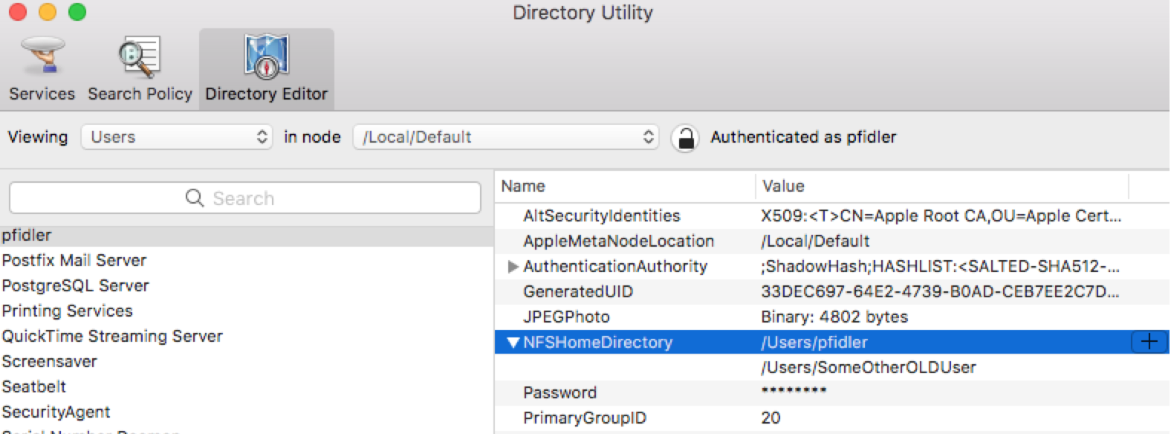
Mac OS X Troubleshooting
Compliance Password Prompts Repeatedly
If any Mac asks to enter the password repeatedly for Cisco compliance and even after entering the correct one,
it keeps poping up, then try the following steps:
Check and confirm that if that Mac has any other local user account (Non Cisco user’s account like TEST).
If yes, then ask the user to backup all data from that account and delete that account.
If there is no other local user account, then make a note of the home folder name of the current user’s
account.
Launch Directory Utility and unlock the lock with user’s credentials and go to Directory Editor and search
for any other old account entry under NFSHomeDirectory apart from the user’s home folder. If there is any old
user entry then delete it.
NOTE: Double check and make sure that you are not deleting the User’s home folder.

Slide 74
Mac OS X Troubleshooting
Compliance Password Prompts Repeatedly
If there is only one entry under NFSHomeDirectory, then Restart the Mac.
Run the following commands on Terminal:
Launchctl unload /Library/LaunchAgents/com.cisco.??pol* Sudo rm –rf /Library/CiscoIT/Scripts/Security/*
Sudo rm –rf ~/Library/Preferences/com.cisco.compliance.plist
Sudo rm –rf /Library/LaunchAgents/com.cisco.??pol*
Restart the Mac.
Run the following commands on Terminal:
sudo touch /Library/CiscoIT/Attributes/.Debug
Sudo jamf recon
Sudo jamf policy
NOTE: Log file location: /Users/USERNAME/Library/Logs/com.cisco.pwpolicy-DEBUG.txt

Slide 75
Mac OS X Inbuilt Application Troubleshooting
Isolating The Issue Whether System Wide or User Specific
If you get any issue related to any application, the root cause might be in either of the cases:
Some issue may occur due to corruption in user’s Library, which classified as User Specific.
Some issue may occur due to corruption in HDD Library or System Library, which is classified as System
Wide
To isolate that always create a local user account with Admin right and try to reproduce the issue on the
newly created account.
If it persists, then eliminate the User’s account or Library and troubleshoot on HDD Library.
If the issue doesn’t occur on the new account, then troubleshoot on effected User’s Library or Account.

Slide 76
Mac OS X Inbuilt Application Troubleshooting
Apple Mail
Refer this article: https://support.apple.com/en-in/HT204075, if any of the following issue occurs:
If you can’t send or receive email on your Mac
If Mail refers to a problem with the mail server or network
If Mail keeps asking for your email password
If Mail says that your account appears to be offline
If email doesn't arrive as soon as you expect
If the Mail app keeps crashing, then perform the following steps:
Quit Mail and delete the following files
~/Library/Preferences/com.apple.mailxxx.plist
~/Library/Saved Application State/com.apple.Mail.SavedState
~/Library/Caches
~/Library/Cookies
Logout and Login to the user’s account and Launch Mail App
If the issue still persists, then Rebuild the Mail database from Mail Menu < Mailbox < Rebuild OR Please
refer user to applecare enterprise support: AppleCare

Slide 77
Mac OS X Inbuilt Application Troubleshooting
App Store
If the Mac App Store doesn’t Launch and keeps crashing:
Restart the Mac
If issue still persists, then delete com.apple.AppStore.SavedState from ~/Library/Saved Application State
If issue still persists, then delete the files from following locations:
~/Library/Preferences/com.apple.appstore.plist
~/Library/Caches
~/Library/Cookies
Log out and login to user’s account
If the issue still persists, then check on another account to confirm whether it’s a System Wide or User’s
Specific issue
If it occurs on another account as well, then we need to reinstall the Mac OS X. If it doesn’t occur on
another account, then we need to migrate user’s data to another account.
If the Mac App Store doesn’t connect, then refer this article: https://support.apple.com/en-us/HT203811

Slide 78
Mac OS X Inbuilt Application Troubleshooting
Contacts
If any user wants to clear duplicates from Contacts, then
Launch Contacts
From the Menu bar, click on Card < Look for Duplicates and clear all the duplicate contacts
If iCloud contacts doesn’t Sync up with Contacts, then
Go to Contacts < Accounts and disable all the other accounts
Go to System Preferences < Internet Accounts and uncheck icloud contacts and check it back
It would synchronize all the contacts
Then you can enable other accounts, like google, yahoo or exchange

Slide 79
Mac OS X Supported Application Troubleshooting
MS Outlook 2016
If the e-mails, contacts, Calendars doesn’t sync on MS Outlook 2016, then try the following:
Go to Keychain Access and search for the entry with ‘Exchange’ and delete that.
Quit and relaunch Outlook and enter the CEC password
If issue persists, then Delete the Cisco Exchange Account from Tools < Accounts and re-configure it
If the issue still persists, create a new Outlook Profile through Outlook Profile Manager from
/Applications/Microsoft Outlook/Contents/SharedSupport/
If issue persists, then create another local admin account and configure Cisco Exchange account on
Outlook on that newly created account.
If issue persists, on new account as well, then uninstall Entire MS Office applications using the uninstaller
script and restart the Mac.
NOTE: Make sure that you have backed up the Outlook profile which has user’s data before uninstallation.
Now reinstall MS Office 2016 and update to the latest version and configure user’s Cisco Account.

Slide 80
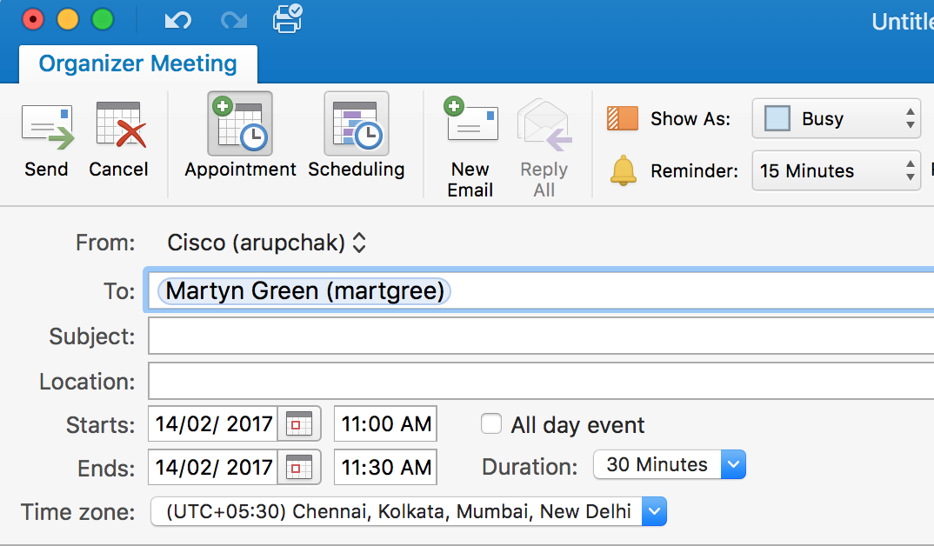
Mac OS X Supported Application Troubleshooting
MS Outlook 2016
If user is unable to view others calendars on MS Outlook 2016, then try the following:
Check and confirm that user is accessing others calendar by going to calendar tab > Meeting > Enter the
other user’s e-mail address in To field and then click on Scheduling.
If it shows the status as Tentative or busy even though in actual its free of the other user’s, then check the
number of calendar events on other user’s Calendar. It would be more than the Outlook supported numbers
and will show a caution.
In that case, escalate the case to Exchange Team to check for duplicate events and also suggest the user
to opt in opt-in to 1 or 2 years of retention policy for of Calendar events.
Reference: Calendar management service

Slide 81
Mac OS X Supported Application Troubleshooting
MS Outlook 2016
If the MS Outlook 2016 goes to frozen state or crashes frequently, then try the following:
Check on the Calendar Tab, if there is any shared Calendars. If yes, then remove all the shared
calendar as it creates a local cache on the Outlook Calendar database.
Also check the number of calendar events on user’s Calendar through Smart support. If it’s showing
any caution sign on Smart support, then escalate the case to Exchange Team to check for duplicate events and
also suggest the user to opt in opt-in to 1 or 2 years of retention policy for of Calendar events.
Reference: Calendar Management Service
If still the Outlook Crashes, then create a new Outlook Profile and check the status. If it works fine on
new Outlook Profile, then there is a corruption with the existing profile data and you need to export
those archived mails, calendars, contacts (if any) to a PST file using OLM to PST converter.
Reference: Data recovery from Corrupted Outlook identity.
If issue persists on another outlook profile as well, then create a Local user account with admin rights
and try configuring Outlook over there and check.
If issue persists, on the other Local user account as well, then uninstall MS Office 2016 using the uninstaller
NOTE: Make sure that you have backed up the Outlook profile which has user’s data before uninstallation

Slide 82
Mac OS X Supported Application Troubleshooting
MS Outlook 2016
Now reinstall MS Office 2016 and update to the latest version and configure user’s Cisco Exchange Account.
If the Outlook 2016 works fine on the other user account, then it’s an issue with Outlook settings on the original account.
Log out and login to the effected user account and quit all the running applications.
Delete the following files and empty the trash.
~/Library/Caches/<all contents of Caches folder>
~/Library/Application Scripts/com.microsoft.outlook
~/Library/Application Support/Microsoft
~/Library/Containers/com.microsoft.outlook
~/Library/Cookies/<all contents of Caches folder>
~/Library/Preferences/com.microsoft.outlook.xxx.plist
~/Library/Saved Application State/com.microsoft.outlook.savedstate
~/Library/WebKit/com.microsoft.outlook
Restart the Mac and then launch Outlook and check.
If the issue still persists, then escalate to Desktop T3 Mac

Slide 83
Mac OS X Supported Application Troubleshooting
MS Outlook 2016
If there is any data missing after importing the profile from Outlook 2011 to Outlook 2016, then scan the
profile of Outlook 2011 using the OLM to PST converter.
If the scan results shows those missing data or folders, then export those to a PST file.
For further instructions, refer: Data recovery from corrupted outlook identity

Slide 84
Mac OS X Supported Application Troubleshooting
MS Excel & PowerPoint
If the MS Excel or PowerPoint 2016 goes to frozen state or crashes frequently, then try the following:
Create a Local user account with admin rights and try accessing Excel or PowerPoint over there and check.
If issue persists, on the other Local user account as well, then uninstall MS Office 2016 using the uninstaller.
NOTE: Make sure that you have backed up the Outlook profile which has user’s data before uninstallation
Now reinstall MS Office 2016 and update to the latest version and configure user’s Cisco Exchange Account.
If the Excel or PowerPoint 2016 works fine on the other user account, then it’s an issue with Excel or PowerPoint settings on the original account.
Log out and login to the effected user account and quit all the running applications.
Delete the following files and empty the trash.
~/Library/Caches/<all contents of Caches folder>
~/Library/Application Scripts/com.microsoft.excel or com.microsoft.powerpoint
~/Library/Application Support/Microsoft
~/Library/Containers/com.microsoft.excel or com.microsoft.powerpoint
~/Library/Cookies/<all contents of Caches folder>
~/Library/Preferences/com.microsoft.excel.xxx.plist or com.microsoft.powerpoint.xxx.plist
~/Library/Saved Application State/com.microsoft.excel.savedstate or com.microsoft.powerpoint.savedstate
~/Library/WebKit/com.microsoft.excel or com.microsoft.powerpoint
Restart the Mac and then launch Outlook and check.
If the issue still persists, then escalate to Desktop T3 Mac.

Slide 85
Mac OS X Supported Application Troubleshooting
Cisco AnyConnect
If Cisco AnyConnect gives an error “ Login Failed”, then try the following steps:
First Validate the VPN token by going to estore and order “ Validate Token “. If it’s successful, then there
is an issue with Cisco Anyconnect; else you will have to rekey the Softoken II or Reactivate MobilePASS.
If it’s an issue with Cisco AnyConnect, then uninstall it by running the Uninstaller from
/Applications/Cisco/Uninstall AnyConnect.app. Also make sure that you have run the Uninstall AnyConnect
DART.app to remove the DART application.
Restart the Mac and reinstall Cisco Anyconnect from estore.
Try to establish VPN through Cisco AnyConnect. If it gives the same error again or another error,
“anyconnect was not able to establish a connection to the specified secure gateway”,
then run the following commands on Terminal App.
cd /Private/
Sudo chmod 777 ./tmp/
Now try again to establish VPN. If the issue still persists, try with different Gateway like San Jos - SSL
If the issue still persists, then escalate the case to AnyConnect Application support Team.

Slide 86
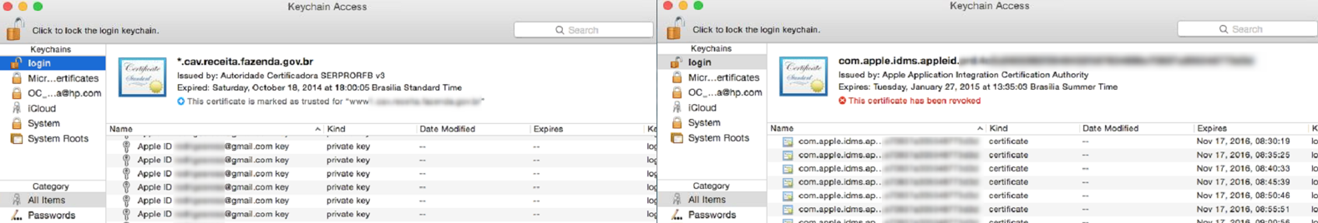
Mac OS X Supported Application Troubleshooting
Cisco AnyConnect
If Cisco AnyConnect gives an error “ Login Denied. Your environment does not meet the access
criteria defined by your administrator ”, then try the following steps:
Quit Cisco AnyConnect Application and Launch Keychain Access.
From the left sidebar select ‘login’ under ‘Keychain’ and ‘All Items’ under ‘Category’.
Delete all these duplicate certificate entries with ”Apple ID xxxx@cisco.com key” and
“com.apple.idms.ap..xxxx” and be sure not to remove anything else except these duplicate entries.
Restart the Mac and then try to connect to VPN.

Slide 87
Mac OS X Supported Application Troubleshooting
SofToken II
If Softoken II doesn’t initialize (Error 507) or the PIN change pop-up window doesn’t appear, then try the
following steps:
Launch Xquartz Application and update it to the latest version and restart the Mac
If the issue still persists, then uninstall and reinstall Xquartz Application.
If still the Softoken II doesn’t initialize, then uninstall Softoken II by deleting it from
/Applications/Softoken II
~/Library/Application Support/Softoken II
~/Library/Preferences/com.cisco.it.softoken2.plist
Restart the Mac and reinstall Softoken II and try to reinitialize it
If it fails again, then it’s recommended to migrate to MobilePASS by going to estore and order
“ Convert Token “. You can download MobilePASS from Mac App store.

Slide 88
Mac OS X Supported Application Troubleshooting
Cisco Jabber (Voice Services)
If the Phone services or Voicemail doesn’t work on Jabber, even though the Instant Messaging is fine,
then try the following steps:
Log Out from Cisco Jabber and Reset Jabber.
Delete the following folders: ~/Library/Logs/Jabber and ~/Library/Application Support/Cisco
Login to phone.cisco.com or voicemail.cisco.com using CEC ID and password. On the pop-up
window, reenter the CEC credentials.
NOTE: Make sure that the Pop-up blocker is disabled on the browser before accessing the sites.
Login to Cisco Jabber, then go to Preferences < Accounts and reenter the CEC credentials for
Phone Services or Voicemail and click on Apply. This should bring the Phone Services or Voicemail in Active
State
If the issue still persists, then uninstall Cisco Jabber by deleting it from /Applications/ and
/Library/Cisco/ and /Library/Messages/PlugIns/ and ~/Library/Address Book Plug-Ins and
~/Library/Preferences and ~/Library/Saved Application State and ~/Library/WebKit
Restart the Mac and reinstall Cisco Jabber from eStore and update to the latest version.
NOTE: ESTS supports issues related to Voice services and for cisco jabber/spark application related issues,
the case should be escalated to RCSS or WHO the call to RCSS queue

Slide 89
Mac OS X Supported Application Troubleshooting
VMware Fusion
If user claims that the Windows VM looses its network connectivity frequently or for Audio/Graphics/Sharing
issues, then try the following steps:
Check the Network on Mac OS X by doing a ping test from Terminal or from Network Utility. If it’s fine on
Mac OS X within the time reported by the user, then it’s an issue with VMware Fusion or the Windows VM.
(Try this step only for Network Issue.)
Update the VMware fusion to the latest version.
Turn On the Effected VM and then uninstall and reinstall the VMware Tools by clicking on Virtual Machines
< Install VMware Tools from the menu bar. Then run Setupx64.exe from
Windows 10 OS < This PC < CD/DVD Drive.
Then select remove option from the setup wizard and then restart the Windows VM and reinstall the
VMware Tools again.
If the issue still persists, then uninstall VMware Fusion by running the uninstaller from VM uninstallation guide
Restart the Mac and reinstall the VMware Fusion from eStore and update to the latest version.
Launch the Windows 10 VM and reinstall the VMware Tools again
If the issue still persists, then we need take data backup from the Windows VM and recreate
another Windows 10 VM.

Slide 90
Mac OS X Supported Application Troubleshooting
VMware Fusion
If any user wants to extend the Hard Drive Size of Windows VM, then follow these steps:
Shut down the Windows VM.
Then select the particular VM and then settings > Hard Disk (SCSI) and set the required volume size.
Turn on the Windows VM. It will not be reflected as the extended space is in raw state.
Open Disk management > Create an extended partition with the newly added space.
Now the additional space will show up as separate drive (not included on C Drive).
NOTE: If user wants the extended space to be added with C Drive, then he has to use third-party application
and there might be a chance of Data loss on C Drive.

Slide 91
MAC OS – Support Overview
Tier 1 – Level 1 or 2 Support Group(s) | Support Tasks/Responsibilities
Mac OS X Support | Desktop T1 Mac should support on Mac OS Sierra and El Capitan and recommend the El Capitan users to upgrade to Sierra OS
Mac OS X Applications | Desktop T1 Mac should support on all in-build Mac OS applications like Mail, Calendars, Contacts, Photos, etc.
Other Applications runs on Mac | Desktop T1 Mac should support most of the other applications used in Cisco like MS Office 2016, Jabber, OnRamp, McAfee, VMware Fusion, etc.
WebEx and Spark | Refer user to RCSS queue as webex and spark is no longer supported by ESTS
Printers Troubleshooting | Anything related to printers’ drivers or printing System on Mac, Desktop T1 Mac should support. If it’s related to printer access or MobilePrint doesn’t work, then escalate to Xerox team.
OnRamp Application | If it’s related to access, then pass it to OnRamp support team after checking on different machines, else Desktop T1 Mac should support.
Notes:
Replace ‘Application Name’ in the Title with the actual Application or Service Name. Quotes can be removed here also.
Replace the examples listed in the first row (not the title row within the table) with the actual details specific to each level of support.
Note: There can be multiple levels of Assignment Groups which would require their own individual row with Assignment Group name and support group description details.

Slide 92

Top or known Issues
Notes:
Replace ‘Application Name’ in the Title.

Slide 93
Top Issues and Solutions
Issue | Description | Solution / Workaround
Search feature not working on MS Outlook 2016 | Unable to search e-mails, Calendars and Contacts | Assign Outlook as Default App for *.olk15Message files and perform re-indexing
Unable to Print from Mac | Unable to print as the print Jobs are getting cancelled automatically | Uninstall Print Audit 6 Application and replace the CUPS folder and reset the printing system
Unable to join to WebEx Meeting | Unable to join to WebEx meeting as it asks to download add-on again and again | Perform a permission repair of Home and root directory and reinstall WebEx PT and Cisco Meeting Center
Outlook Freezes | Outlook goes to frozen state while switching between Mail and Calendar window | Removed all shared calendars and suggest the user to archive or delete old calendars, if it’s more
Onramp Issue | Unable to login to Onramp Application | Clear all the stored password from browsers and Keychain Access and also clear browsers cache and cookies
Network Issue | Unable to connect to Blizzard | Delete entries from Keychain
Notes:
Replace ‘Application Name’ in the Title with the actual Application or Service Name. Quotes can be removed here also.
Please keep in mind, the examples listed in the first row should be overwritten by the actual categories.
Refer to this page for the list of static Categories: https://cisco.jiveon.com/docs/DOC-1734471
Only the categories that apply to the Service Offering for the top issues should be listed on the slide.

Slide 94
Associated Links / Sites

Slide 95
Mac OS Support – Associated Links
Title | Associated Links
Mac OS X Troubleshoting Guide | Technical Support internal - MAC
Mac New Hire OS X Setup | OS Set up – MAC
Mac to Mac Refresh OS X Setup | MAC to MAC Refresh
Mac Reimage OS X Sierra Setup | MAC reimage
Mac OS X High Sierra Upgrade | MAC – High Sierra upgrade
Windows 10 VM running on VMware Fusion | VMware set up
Repairing a sparse virtual disk in Fusion (1023888) | https://kb.vmware.com/selfservice/microsites/search.do?language=en_US&cmd=displayKC&externalId=1023888
Troubleshooting guide of Outlook 2016 Mac | MAC – Outlook 2016
How to recover data from Corrupted Outlook Identity on Mac | MAC> Data recovery from corrupted Outlook identity
Notes:
Replace ‘Application Name’ in the Title with the actual Application or Service Name. Quotes can be removed here also.
Is the location coverage global to Cisco or is it specific to a Cisco region or Extranet Partner site location
Note: Initial rollout volume (which could be dependent on a scheduled deployment) can be different than steady state projected volume (once initial impact is completed).

Slide 96
Mac OS Support – Associated Links
Title | Associated Links
Calendar Purging Management | Calendar Management Service
Unable to Search e-mails on Outlook 2016 on Mac | Outlook search issue
How to Uninstall Box Sync | https://community.box.com/t5/Box-Sync/How-Do-I-Install-or-Uninstall-Box-Sync-4-0/ta-p/85
How to uninstall Java on Mac | https://www.java.com/en/download/help/mac_uninstall_java.xml
Re-enable Java web plug-in and Web Start features | https://support.apple.com/en-in/HT202643
Mac OS X Startup Issues | https://support.apple.com/en-us/HT204156
Transfer data using Migration Assistant | https://support.apple.com/en-in/HT204350
Anyconnect Self - help | Anyconnect – Self help

Slide 97
Mac OS Support – Associated Links
Title | Associated Links
Mac OS X: Using Keychain Access to search directory services for certificates | https://support.apple.com/en-in/HT201993
If your Mac keeps asking for the login keychain password | https://support.apple.com/en-us/HT201609
Smart badge - Configuring Email Clients for Signing/Encrypting with S/MIME | https://cisco.jiveon.com/docs/DOC-151311#ol2013
How to create a new profile on Outlook 2016 | Outlook>New profile
How to remove an re-add the Exchange account on Outlook 2016 | Outlook>Remove and Re-add exchange account
Mac Hardware - Global Support Options | MAC - HW
Case Standards - Mac global support | Help Zone - Case Standards - Mac

Slide 98
Q & A

